Slide 1
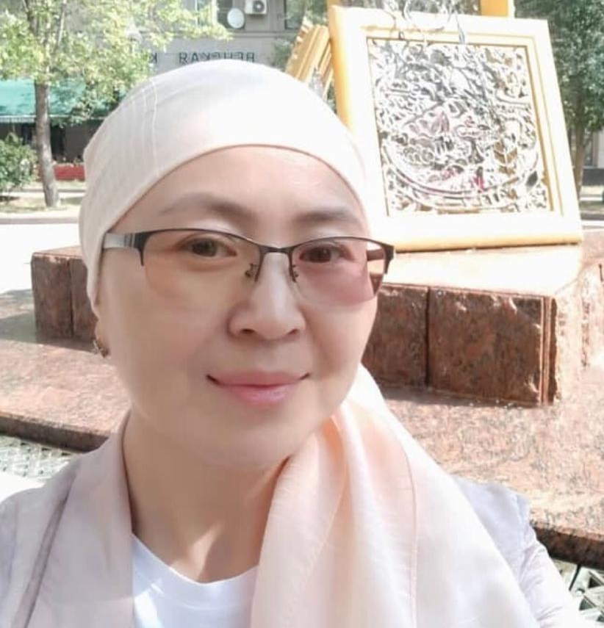
Turusbekova Akshoola Kozumanbetovna

Slide 2
PERSONAL INFORMATION
1. Turusbekova Akshoola Kozmanbetovna, born in 1980, Kyrgyz, associate professor, candidate of medical sciences, obstetrician-gynecologist of the highest category.
2. In 2003 she graduated from Osh State University, Faculty of Medicine.
3. On June 1, 2012 she defended her Ph.D. thesis - Epidemiological and socio-economic characteristics of some infectious diseases in the Osh region at the present stage.
4. Experience in teaching at universities - 16 years, including at Osh State University - 13 years.
5.Scope of professional activity: obstetrics and gynecology, epidemiology, microbiology.

Slide 3
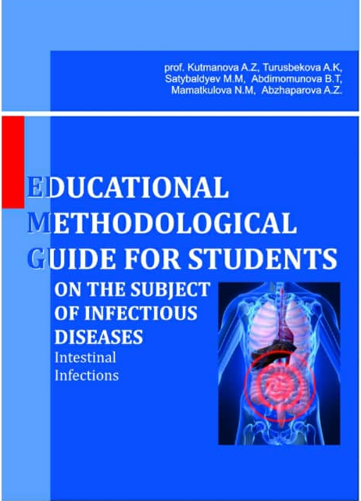
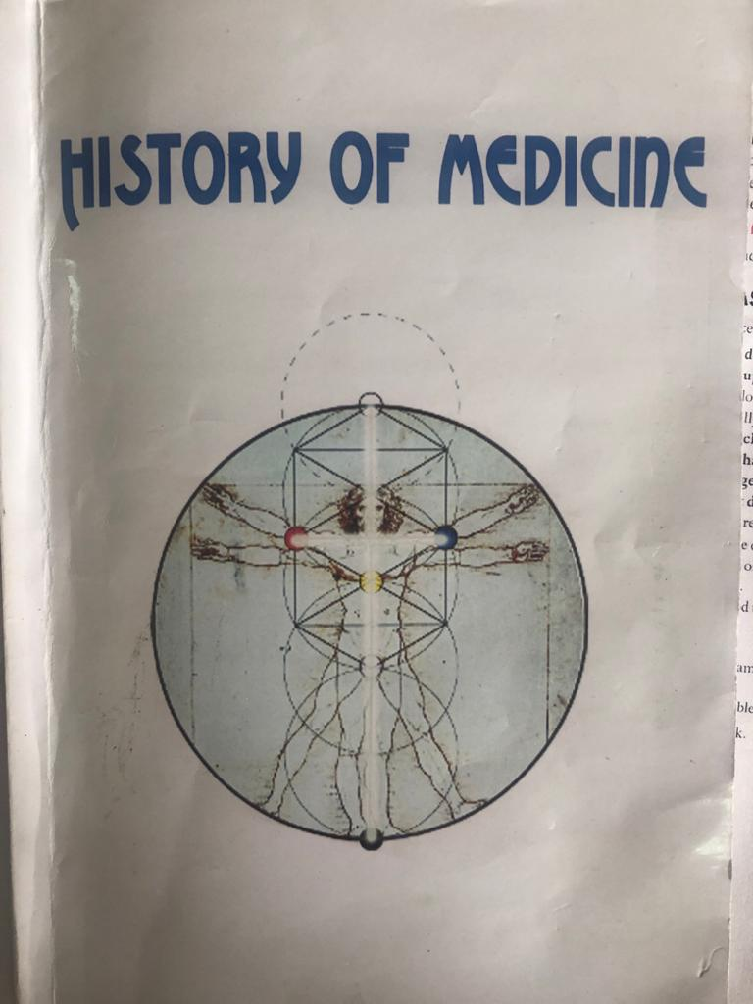
Publications
Has more 32 publications, of which 27 are scientific and 5 educational and methodological.
Main works:
1. Epidemiological manifestations of the ecology of pathogens of natural focal zoonosis in the south of Kyrgyzstan - Bishkek. -2008. -Volume XIV, Appendix 1.P.88-89.
2. Environmental aspects of modern epidemiology of some infectious and parasitic diseases in the southern region of Kyrgyzstan. - - Bishkek. -2008. Volume XIV, Appendix 1.P.89-91.
3. Prevalence of STI morbidity in women of fertile age (based on materials from Osh oblast) Central Asian Medical Journal. Bishkek. -2008, -Volume XIV, Appendix 1.P.100-103.
4. Epidemiological features of intestinal infections in the Osh region in modern conditions. Bishkek 2008. Volume XIV Appendix 1. P.100-103.

Slide 4
Key qualifications
21-22.05.15 participation in the training "Self-assessment of the university, writing a self-assessment report" "EdNet"
2016 Retraining primary spelization in the specialty "Epidemiology"
22-23.04.16 - Participant of the international conference "Epidemiology, pathogenesis and sanogenesis of diseases in changed climatic and geographical conditions"
05/18/19/17 participation in the "II Congress of General Practitioners and Family Physicians of Kyrgyzstan"
04.03-30.06.17 Erasmus plus project "Strengthening the network of education, research and innovation in environmental health in Asia“
29-30.11.18 "B-learning modules in occupational and environmental health"
12-13.04.19 Read a course of lectures at BukhGMI named after Abu Ali ibn Sina in the framework of cooperation between Osh State University and BukhGMI
12-13.04.19 "Current state, problems and prospects of medical education" BukhGMI Uzbekistan.

Slide 5
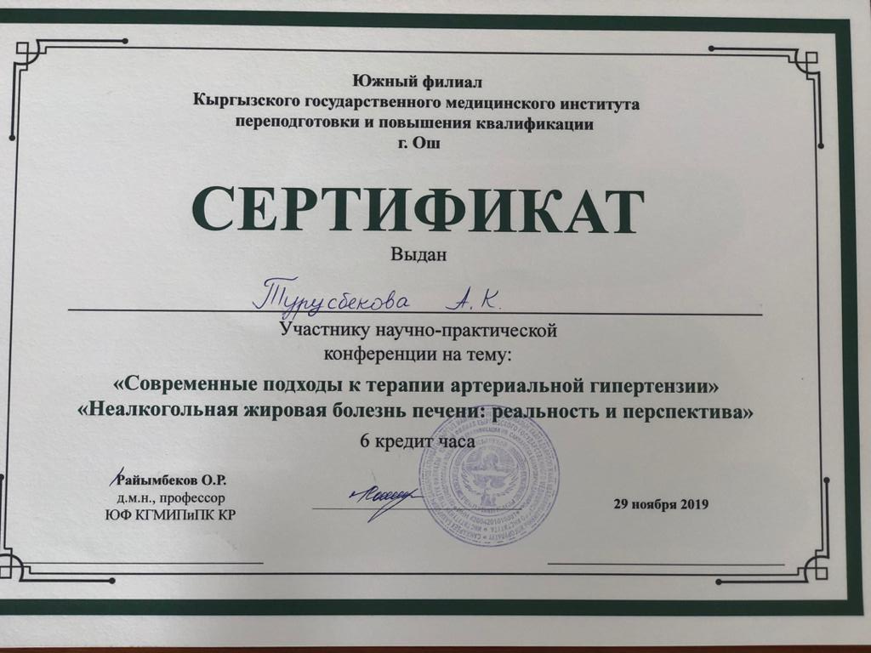
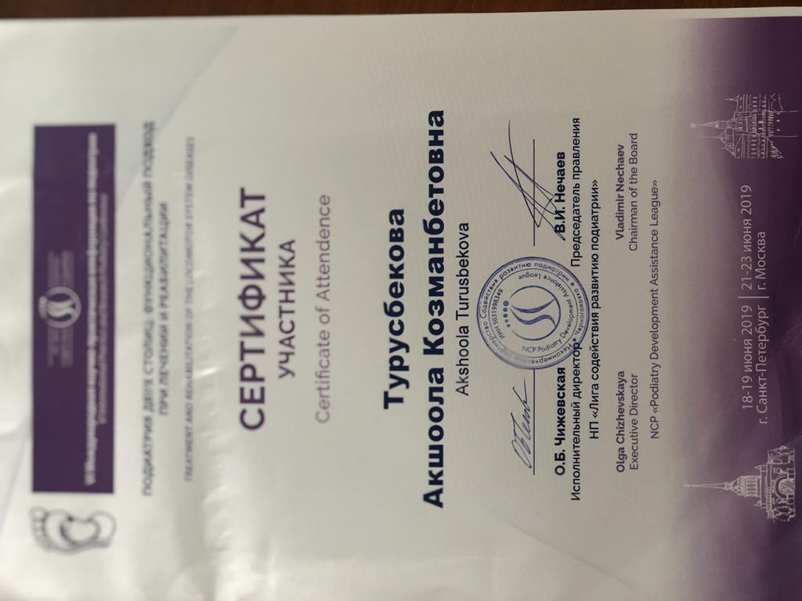
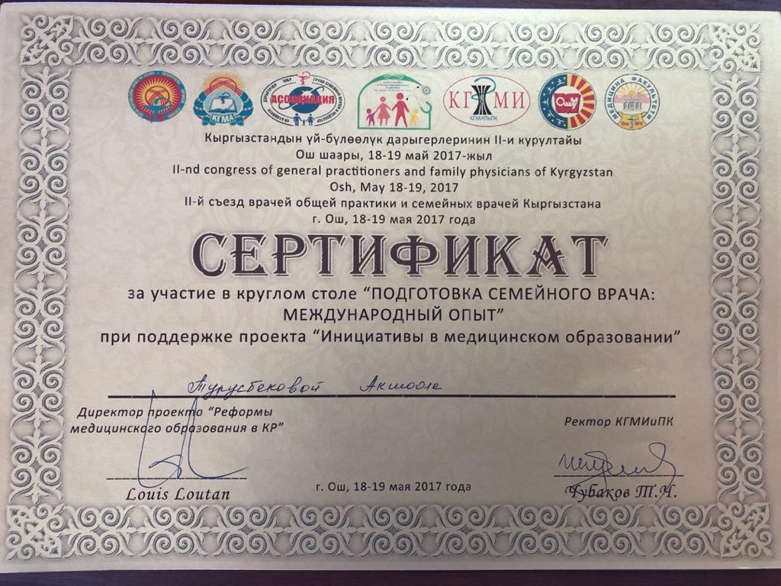
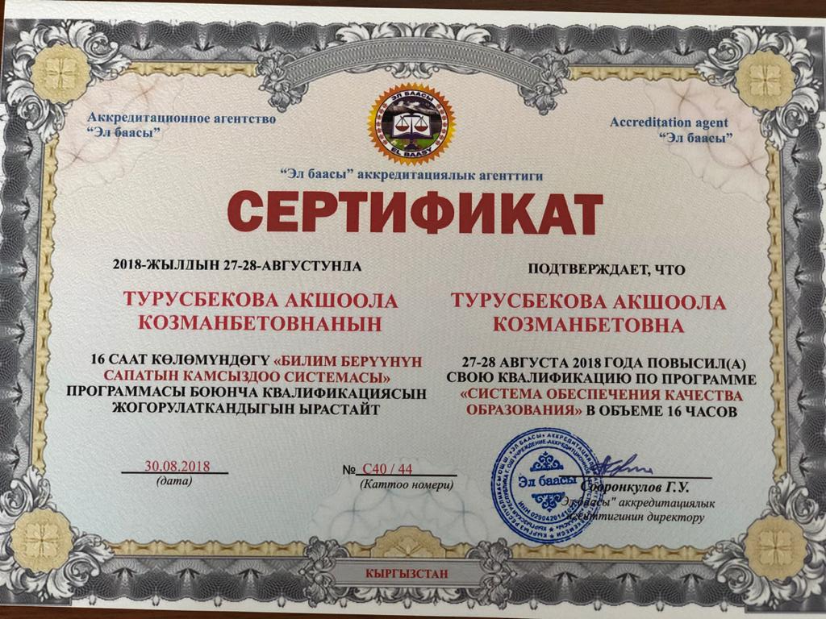

Slide 6
Work experience
2003-2006 OshKUU, medical institute
2006-2015 Osh State University, Faculty of Medicine, Department of Microbiology, Epidemiology and Infectious Diseases
Since 2015 I am currently working at the International Medical Faculty, Department of Public Health and Health Care.

Slide 7
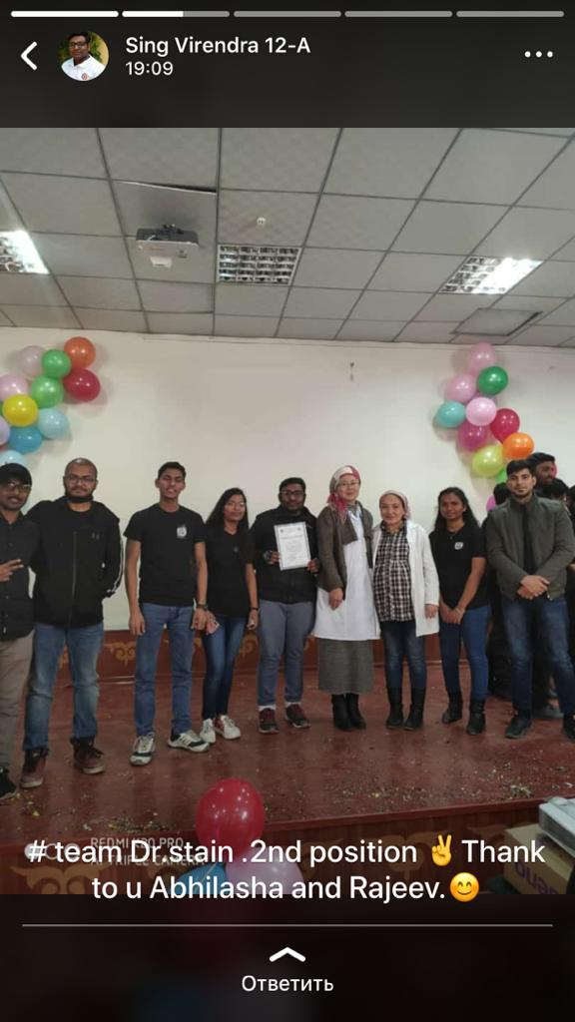
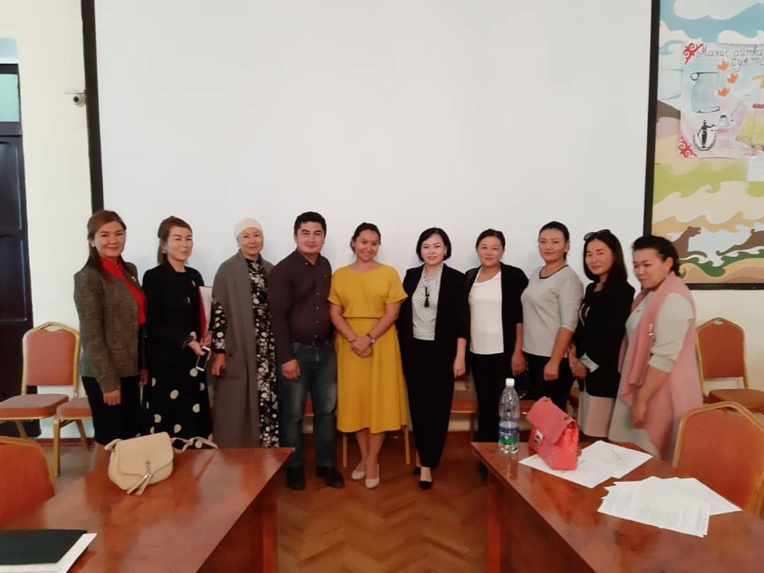
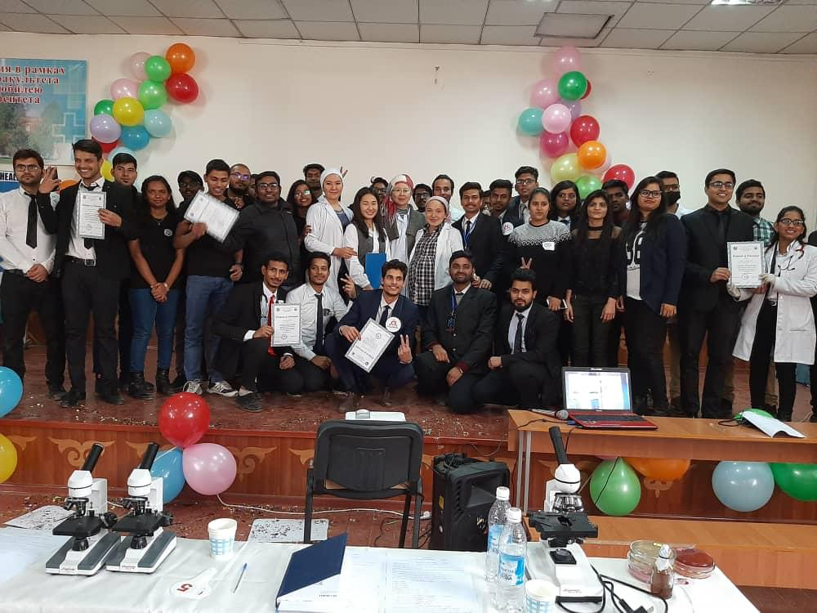

Slide 8
Contacts
Phone number
+996555109070
E-mail:
turusbiekova.akshoola.80@gmail.com

