Slide 1
Decade. IMF. Pathology, basic and clinical pharmacology tbl, Cbl, pbl, rbl
AZIZA SEITOVA

Slide 2
Actuality of interactive methods
correspond to a person-centered approach, as they imply co-learning
is based on the students ' own experience, their direct interaction with the area of their professional experience.
motivates students

Slide 3
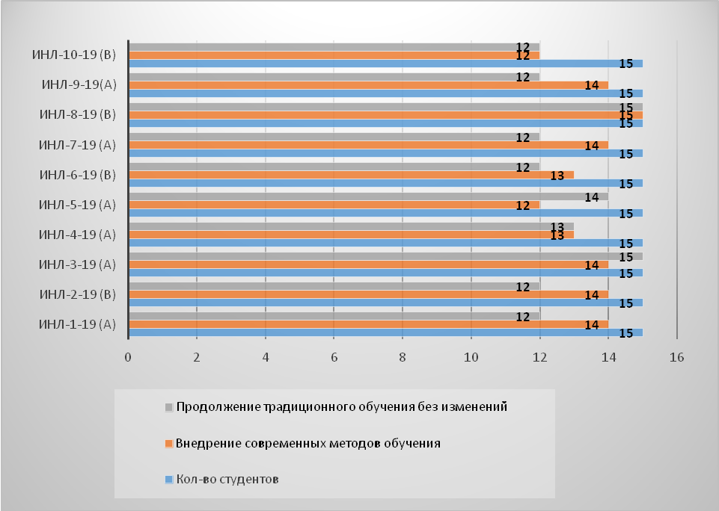
The analysis of the student survey showed that more than 90% were in favor of increasing the number of such modern teaching methods, and 10% were in favor of continuing traditional education without changes.

Slide 4
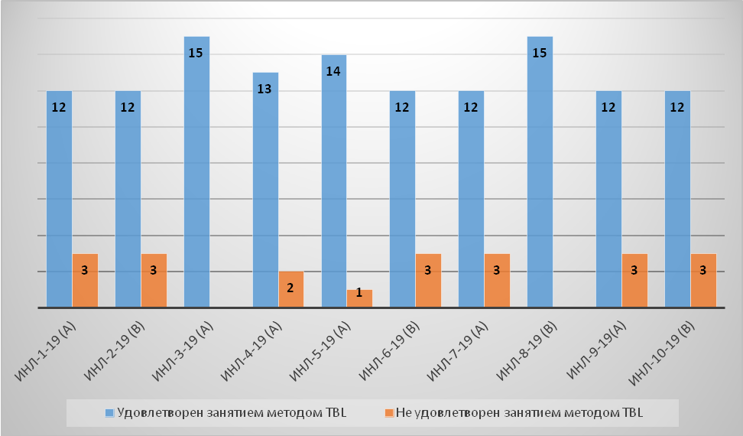
From this table, it can be argued that 86 % of students were satisfied with the TBL lesson and in the proposal to improve the conditions for the personal development of students, they note the importance of conducting this kind of lesson using modern teaching methods.

Slide 5
Conclusion
TBL, CBL, RBL training contribute to a longer retention of the material studied and the development of clinical thinking.
With these methods of completing application tasks, students develop the ability to use course concepts to understand and solve problems.
Interpersonal and team interaction skills are developed, which contributes to learning with understanding.
This combination will allow you to rationally organize the educational process.

Slide 6
Thank you!

