Slide 1
Decade. IMF. Pathology, basic and clinical pharmacology Cloud technology in education
pathological anatomy teacher
SEITOV TeMIRLAN.

Slide 2
Actuality of interactive methods
1.Motivation for lifelong learning(мотивация к непрерывному обучению)
2. Strong virtual classroom environments(Сильная виртуальная классная среда)
3. Ease of accessibility(Легкость доступа)
4. Extensive cost-savings(Значительная экономия средств)
5. Secure data storage(Безопасное хранение данных.)

Slide 3
6. Scalability(Масштабируемость)
7. Agility and innovation(Гибкость и инновации)
8. Greater reach for the students(Более широкий охват студентов)
9. Minimal hardware requirements(Минимальные требования к оборудованию.)

Slide 4
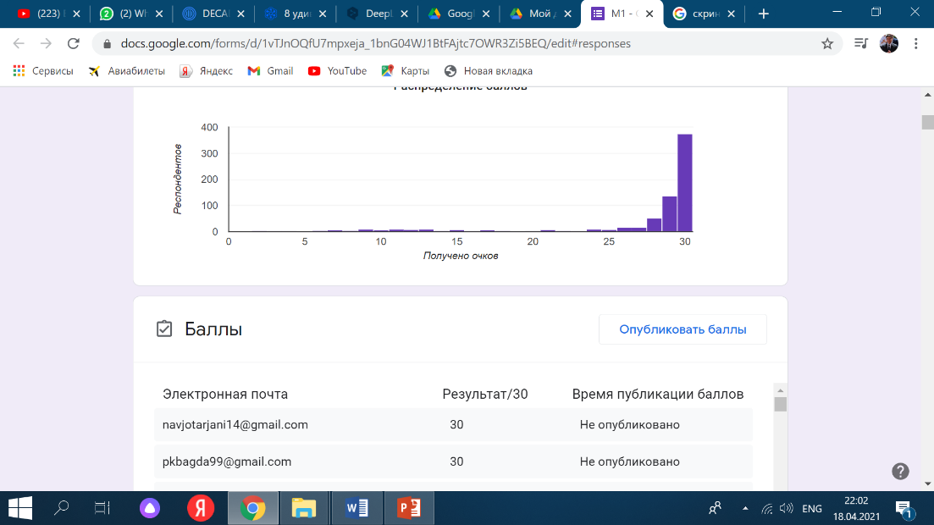
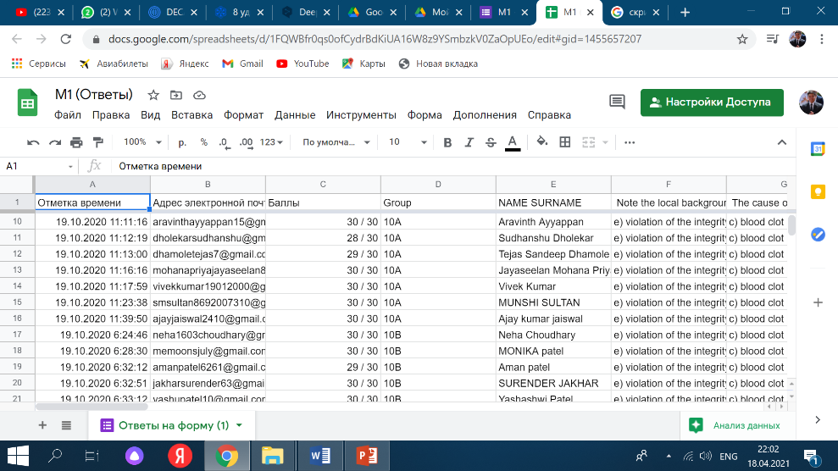
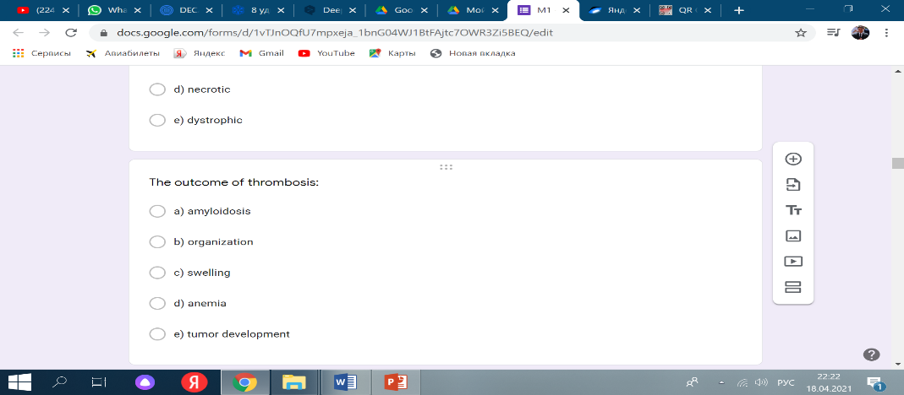
Here's how we use cloud technology. 1. for exams

Slide 5
For for storing data (library) yandex disk

Slide 6
The feedback from students is positive. Because they are closer to technology and leads to a quality education, even at a remote location.

Slide 7
Types of cloud that we can use

Slide 8
Conclusion :
Our university has always kept up with the times, and this type of interactive teaching method is no exception. saving all data and working with students at the same time has made our work much easier and has given us and to our students even more motivation

Slide 9
Thank you!

