Slide 1
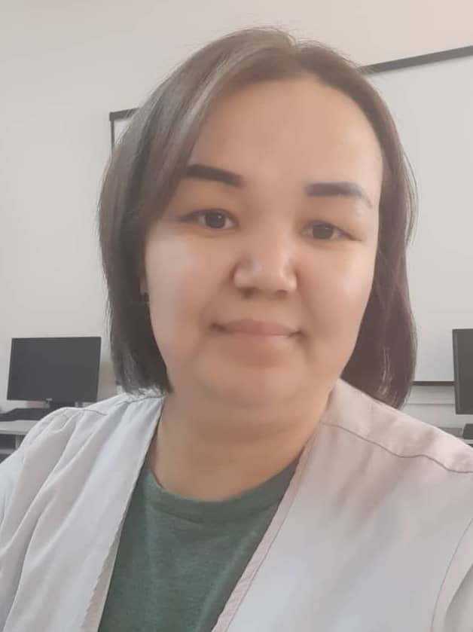
Portfolio
PERSONAL DETAILS
Full name Moldobaeva Aigul
Date of birth 15.04.1985
Work station Osh State University, IMF
Position Teacher at IMF
Teacher discipline Biochemistry
Teaching experience 11 years
Contact phone +996556201812
Email address aigul.moldobaeva@inbox.ru
My motto is: Life is like riding a bicycle. To keep a balance you must keep moving.

Slide 2
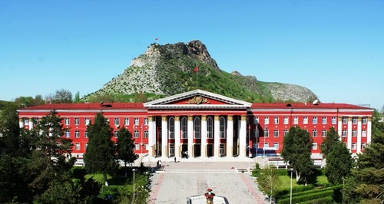
Portfolio of the teacher of the discipline “BIOCHEMISTRY” moldobaeva aigul.
OSH STATE UNIVERSITY INTERNATIONAL MEDICAL FACULTY DEPARTMENT OF NATURAL SCIENCES AND MATHEMATICS

Slide 3
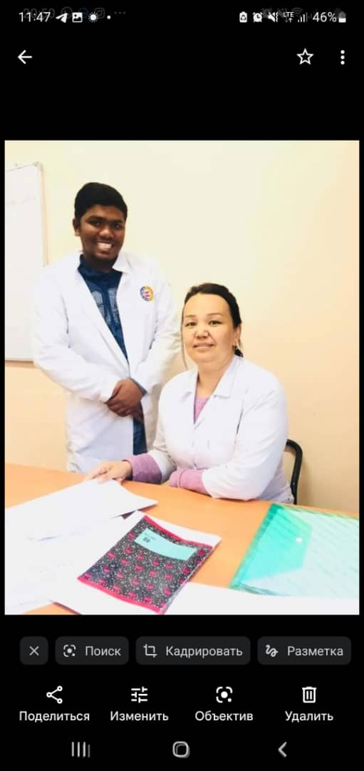
Course and Lesson Planning
Tell me and I forget, teach me and I may remember, involve me and I learn.”
- Benjamin Franklin
In 2006, I first started working as a school teacher.
In 2001, I worked as a laboratory assistant at the medical faculty of Osh State University.
“• When I first started as an instructor in fall 2015, I
developed my syllabus and notes based on
Kyrgyzstan's University and other country. Over
the last few years, I've made adjustments to the
course structure based on trial and error and
student feedback.
• I am interested in science-based learning, project based learning, using inquiry methods, soft skills,
over all student-centered learning, that's how I use
the tools, methods, and experience to aid learners.

Slide 4
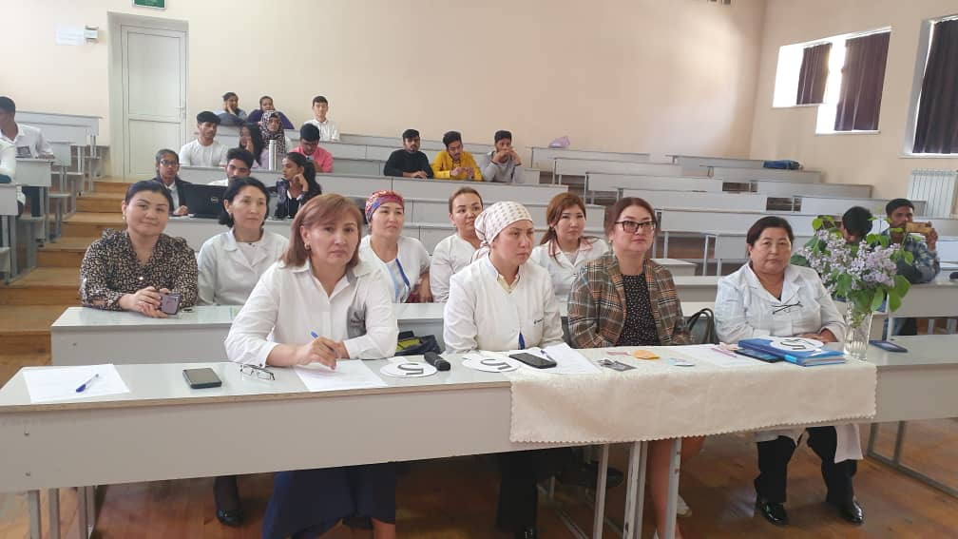
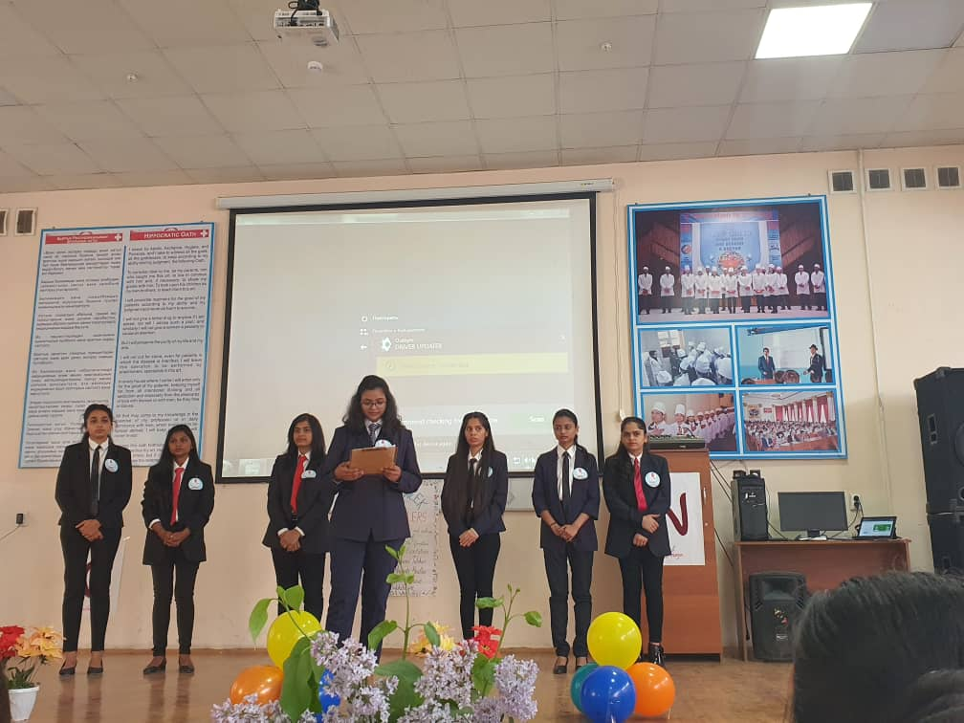
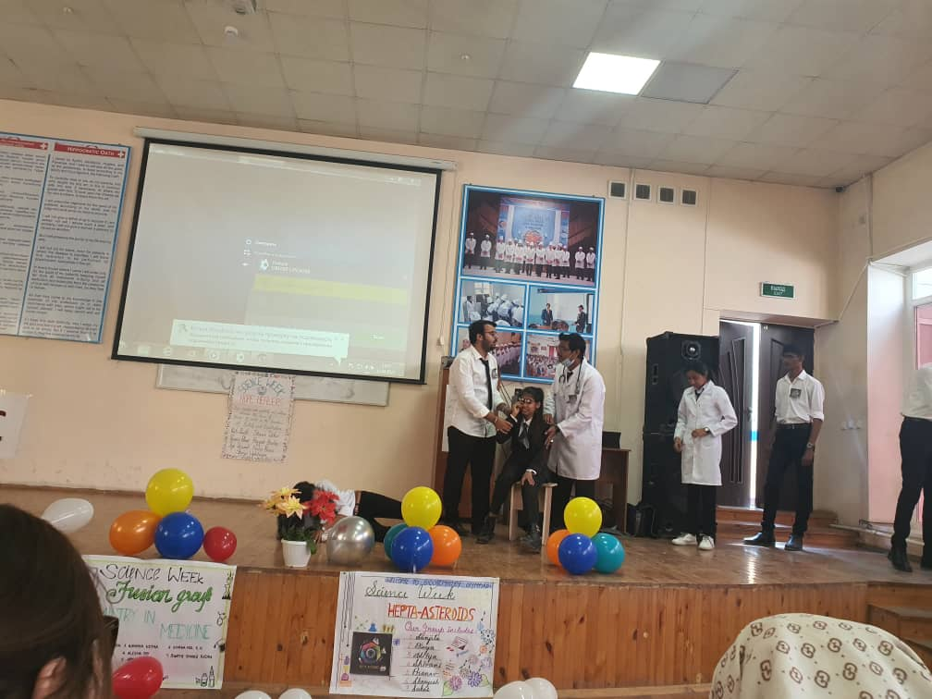
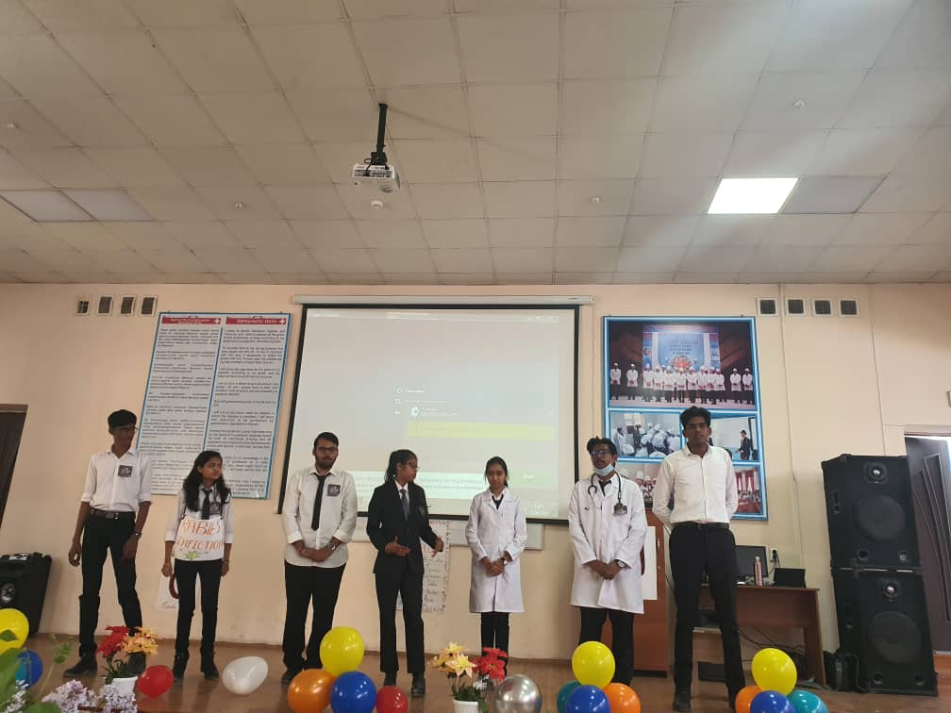
Achievements of my students
Every semester Olympiods are held in the discipline. Students take an active part and those who receive prizes are rewarded with additional points.

Slide 5
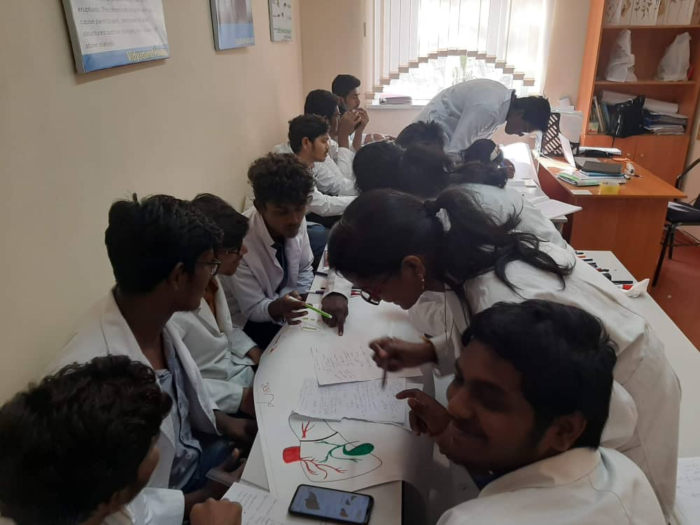
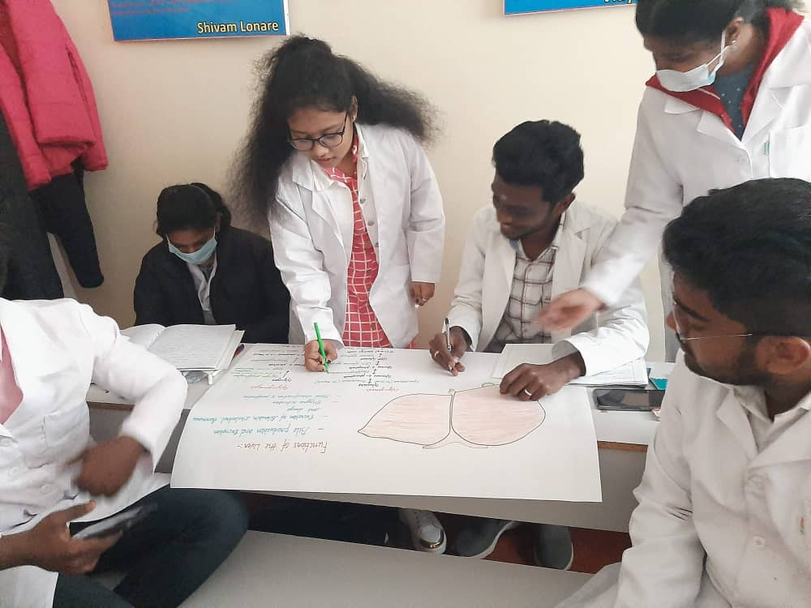
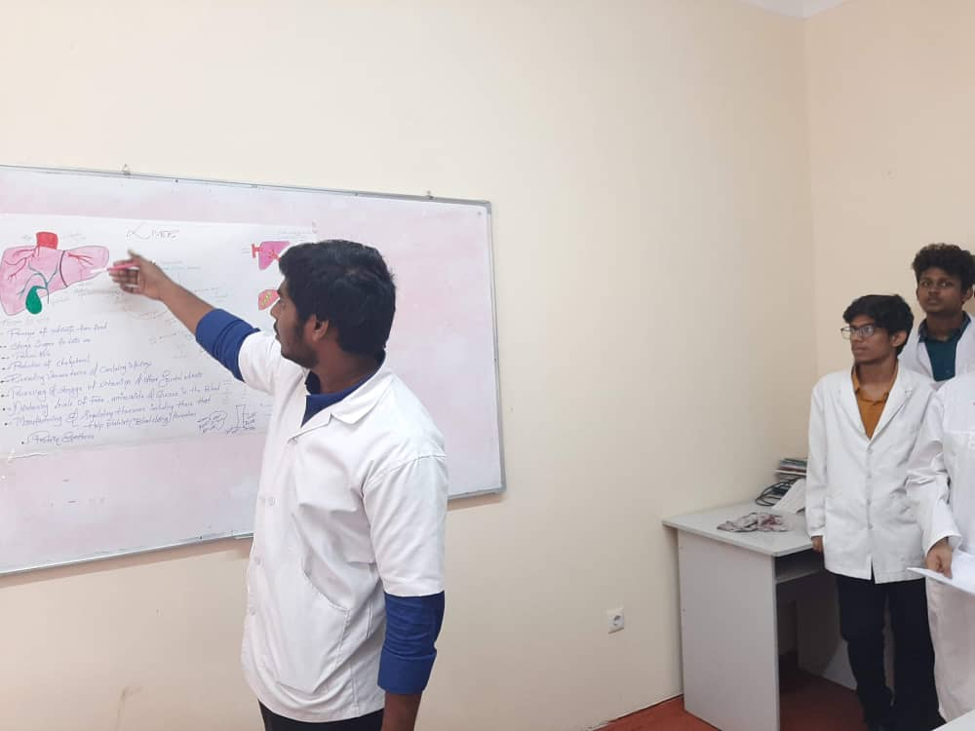
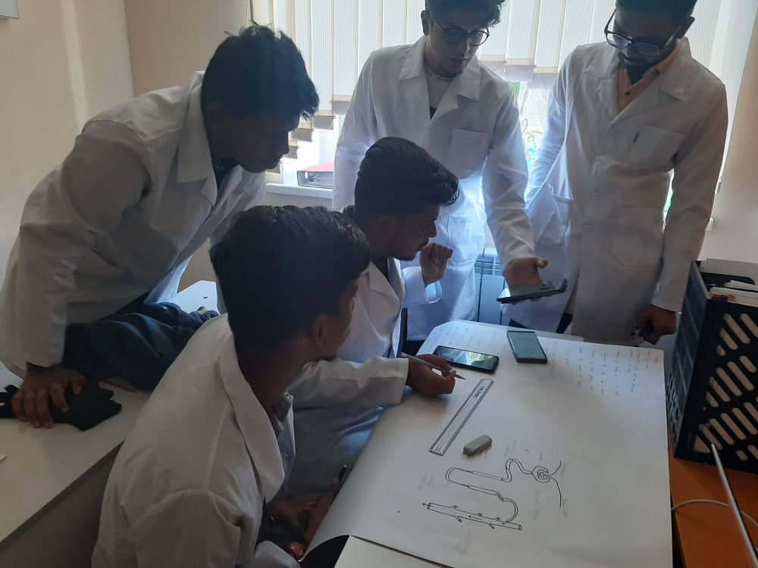
Students work independently on clinical biochemistry

Slide 6
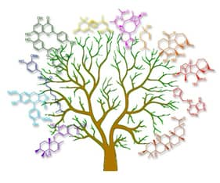
Research
“Research is formalized curiosity. It is poking and prying with a purpose.”
Zora Neale Hurston
.
• One of the most important parts of my Master's degree studies is research.
• Being a researcher requires me to search for further information, and know
when to ask for help from my advisor and other peers and faculty. Being able
to take what is known and apply it to a problem or use theorems to set
standards is one of the main reasons I love my work.

