Slide 1
OSH STATE UNIVERSITY INTERNATIONAL MEDICAL FACULTY NATURAL SCIENCES AND MATHEMATICS
Portfolio of the
teacher of the
discipline “biology”,
“Medical biology, genetics, parasitology”
Tairjanova Menay

Slide 2
PERSONAL DETAILS
Full name of the teacher Tairjanova Menai Tairjanovna
Date of birth 28.11.1993.
Work station Osh State University, International Medical Faculty
Position Teacher at IMF
Teacher discipline “biology“ “Medical biology, genetics, parasitology”
Teaching experience 1 year

Slide 3
About me
I was born and raised in the beautiful city of uzgen, famous for its rice.
Graduated from the Osh State University Faculty of Natural Sciences and Geography
My hobby is reading books and walking in nature
I am currently working a full time position focusing on medical biology, genetics, parasitology at International Medical Faculty of Osh State University.
I am willing to imprave my knowledge and research in this field

Slide 4
scientific degrees
June 18, 2014 Medical College Osh State University
June 22, 2017, he graduated f the Faculty of Natural Sciences and Geography of OshSU
June 22, 2019, Ms in Biology the Faculty of Natural Sciences and Geography of OshSU with a master's degree
2022-presen the international medical Faculty OshSU
published 3 articles

Slide 5
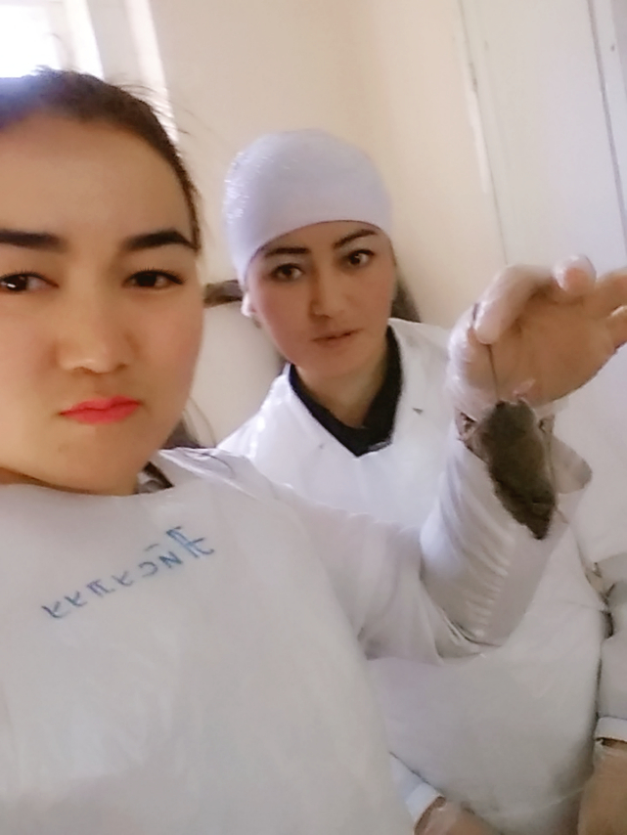
Research “Research is formalized curiosity. It is poking and prying with a purpose.” - Zora Neale Hurston

Slide 6
Contact
E-mail: tairjanova@gmail.com mtairjanovna@oshsu.kg
Whatsapp +996225941919
Occupation: International Medical Faculty, Osh State University

