Slide 1
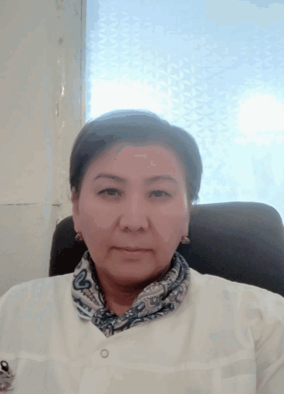
Venera Azhikulova Satvaldieva
Per aspera ad astra.

Slide 2
Personal information
Born on 27.07.1972 in Suzak, Kyrgyzstan.
Graduated From Kyrgyz State Medical Academy in Bishkek in 1997
In 1998 finished one-year internship at the Clinical Hospital of Osh.

Slide 3
Key qualifications
Certificate for perfect attendance at the 3rd International Thermal & Healthcare Travel Summit, City of Fish Doctors Sivas, Turkey.
Certificate for attendance at the scientific-practical conference on the topic of “Dermatological Reading” by the Association of Dermatologists and Cosmetologists of Kyrgyz Republic.
Certificate for attendance at the XXXth international scientific-practical conference on the topic of “Tendency of Development of Science and Education”.
Certificate confirming passing the training-seminar by the Agency on Accreditation of Educational Programs and Organizations on the topic of “Conduct of Independent Accreditation of Programs and Organizations of Professional Education”.
Certificate confirming passing the training by the Agency of Guarantee of Quality in the Field of Education “EdNet” on the topic of “Training of the Experts on Independent Accreditation.

Slide 4
Certificate confirming attendance at the 1st visiting scientific-practical school-conference RNOI in Kyrgyz Republic on the topics of “Issues of clinical immunology” and “Present Issues of Immune Deficiency States in Pediatrics”.
Certificate confirming attendance at the XXXth international scientific-practical conference “Science Yesterday, Today, Tomorrow”, and conforms the publication of an article in the collection “Epidemical Features of Morbidity of Micro-plasma and Mixed Infections in Etiology of Spread Diseases. (Literally Overview)”.
Certificate confirming attendance at LI international scientific-practical conference “Modern Medicine: Present Issues” and conforms the publication of an article in the collection “Persistence of Anti-Chlamydal Antibodies in Clinically Healthy Personnel of Diagnostical Laboratories of Military-Medical Facilities.
Certificate confirming the passing of training on the usage of professional trichological program “Time to Grow”.
Certificate confirming taking part in the training on the topic of “Gender Aspects of Programs of Lowering Harm”.

Slide 5
Certificate confirming passing of further training on the program of “Issues of Infection Control in Healthcare Organizations”, Kyrgyz National Institute of Further Training and Re-education.
Certificate confirming passing of further training on the program of “Selected Issues of Modern Management in Healthcare”, Kyrgyz National Institute of Further Training and Re-education.
Diploma for taking part in the “Best Educator” competition in urology and venereology department. Osh State University.
Certificate confirming passing of further training on the program of “Organization of Information Online-Connections for the Personnel of Medical Organizations of Kyrgyz Republic”, Kyrgyz National Institute of Further Training and Re-education.
Certificate confirming passing of further training on the program of “Pedagogy and Psychology Innovation Technology”, Osh State University.
Diploma of Higher Medical Education in General Medicine, specialty of a Medical Doctor. Osh State University, Osh, Kyrgyzstan.

Slide 6
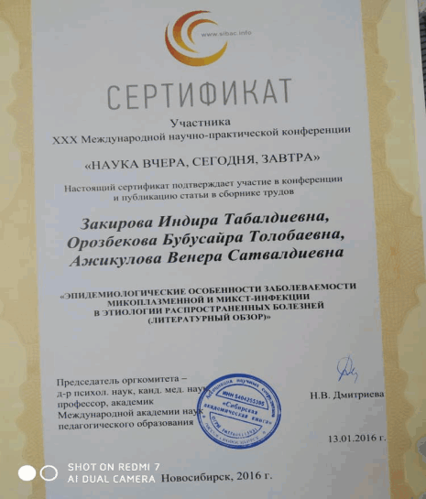
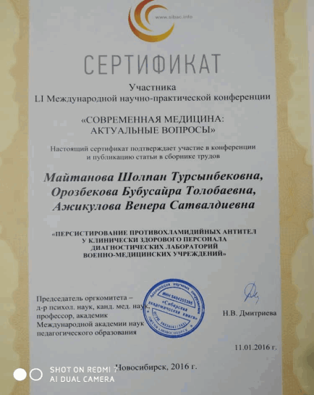
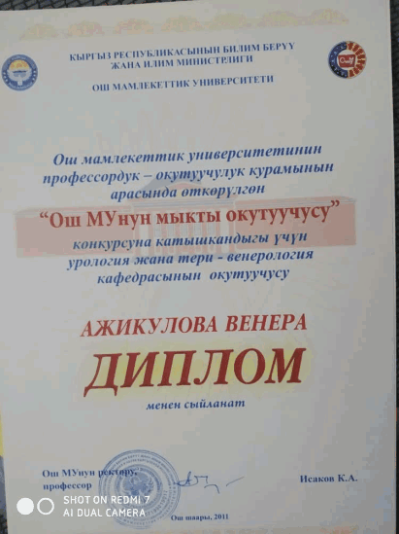

Slide 7
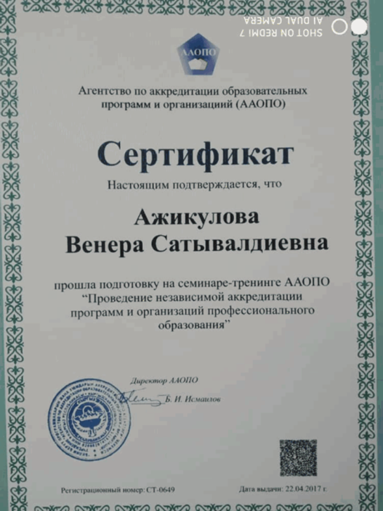
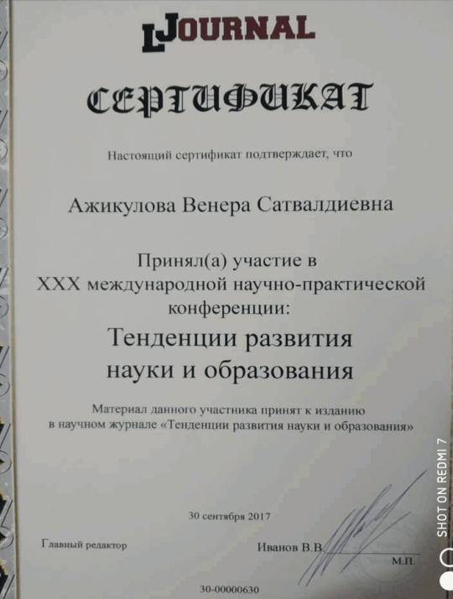

Slide 8
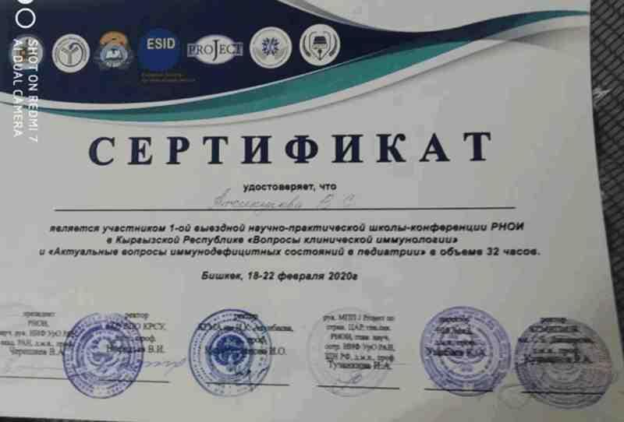
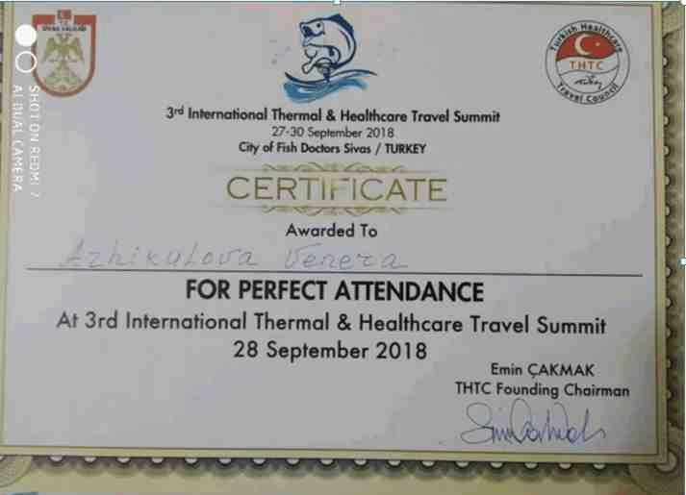
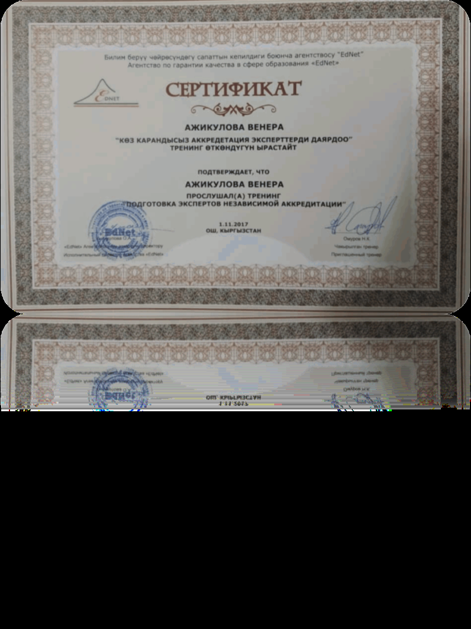

Slide 9
Work experience
In 1998 took up employment at Osh Interregional Center of Dermatovenereology as a Doctor of Dermatovenerology.
From 2008 started work as an educator in Medical College of Osh in the Dermatology Department.
From 2009 started work as an educator in Osh State University in the departments of of urology, operational surgery and dermatovenerology.

Slide 10
Contacts
Cell Phone: 0555603215, 0777334068
Email: azhikulova2019@mail.ru

