Slide 1
Osh State University College of International Education Programs

Slide 2
CHAIRMAN OF TANSLATORS
AKHUNZHANOVA ZHYLDYZ IKRAMZHANOVA

Slide 3
DATE AND PLACE OF BIRTH - 02.12.1970, OSHSITY, UZGEN DISTRICT, KYZYL-DYIKAN VILLAGE
NATIONALITY - KYRGYZ
CITIZENSHIP - KR
PLACE OF WORK: OSH STATE UNIVERSITY
POSITION: LECTURER AT THE DEPARTMENT OF TRANSLATOR
WORK EXPERIENCE - 14
EXPERIENCEIN OSHSU – 14
MOBILE PHONE:+996770323206
E-MAIL.mail:ahunzhanova.j78@mail.com

Slide 4
Education
1989-1994 years - OshSU, faculty of Kyrgyz Philology
Speciality: Teacher of Kyrgyz language and literature
2018 year - OshSU, Department of Graduate and Science
2021 year - completed postgraduate studies at OshSU
WORK EXPERIENCE
1994 year - Lecturer at the Department of Linguistics, faculty of Kyrgyz Philology, OshSU
2015 year - Lecturer at the Department of Social-
Humanitarian Disciplines in International Medical faculty, OshSU.

Slide 5
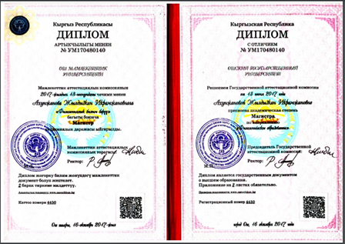
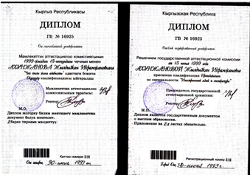
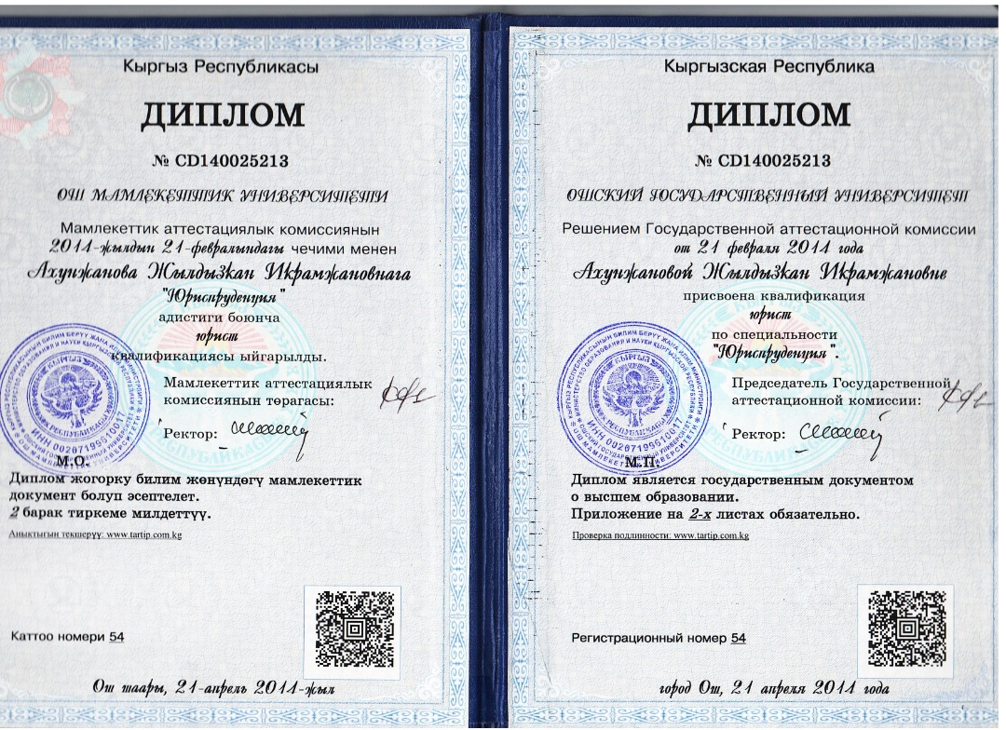

Slide 6
