Slide 1
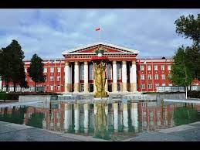
Osh State University
College of International Education Programs

Slide 2
TURGUNBAEVA UULKUL ZHEENMYRZAEVNA ENGLISH TEACHER

Slide 3
Date of birth: 26.01.1983
Citizenship : Kyrgyzstan
Nationality: Kyrgyz
Telephones: : +996222757606
Home address: Osh.Musaev street 48
e-mail:turgunbaevauulkan270@gmail.com

Slide 4
EDUCATION
2000-2005 OshSU The Faculty of World Languages
WORK EXPERIENCE
2007-2013 The teacher
OshSU FWL
2020-2022 The teacher
OshSU CIEP

Slide 6
