Slide 1
Osh State University College of International Education Programs

Slide 2
Ryskulova Nurgul
Ydyrysovna
ENGLISH TEACHER

Slide 3
Date of birth: 06.02.1974
Citizenship : Kyrgyzstan
Nationality: kyrgyz
Telephones+996554460074
Home address: Osh Kara-Kulzha MJK 4
e-mail:@ryskulovanurgul2@gmail.com

Slide 4
EDUCATION
1991-1996 OshSU The Faculty of World Language
WORK EXPERIENCE
1996-2001 English teacher School named after A.Kalmatov
2001-2010 English teacher №21 A.S.Pushkin
2010-2018 English teacher U. Salieva Lyceum-School
2018-2022 English teacher Kyrgyz Uzbek University

Slide 6
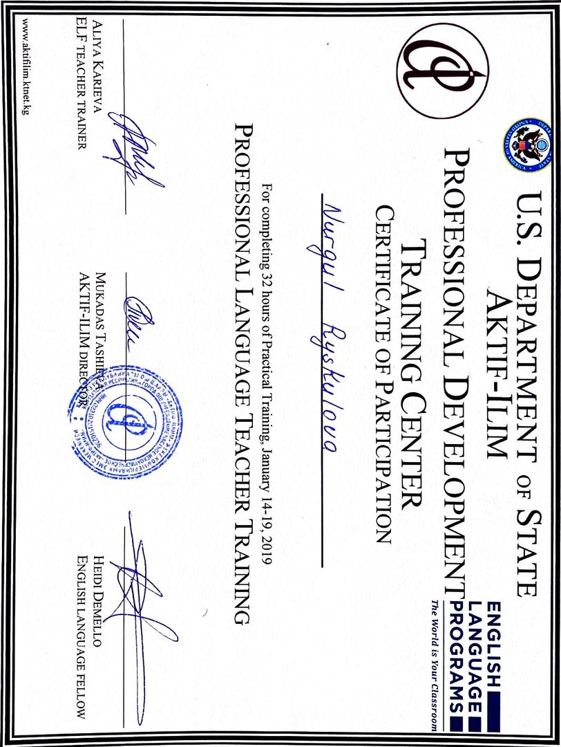
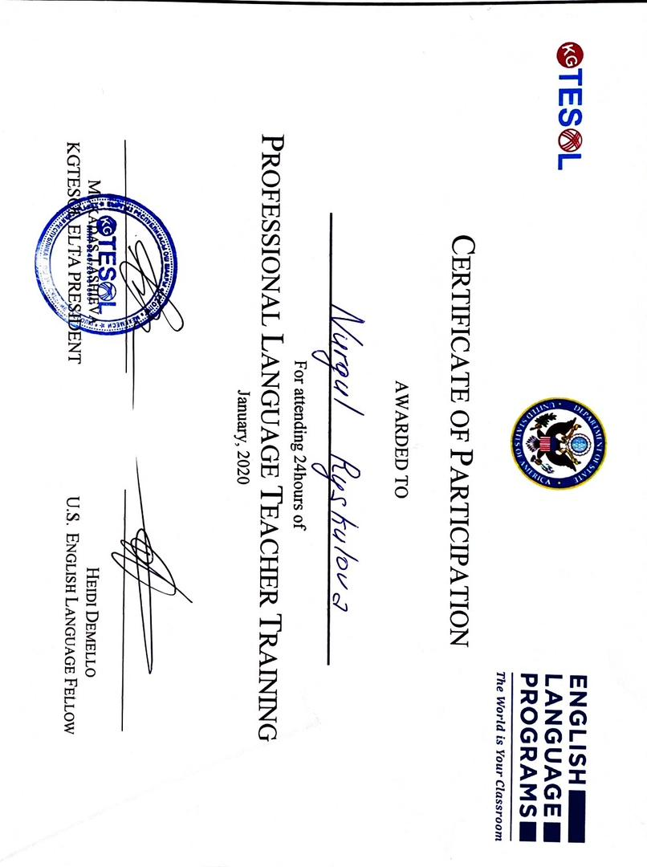

Slide 7
