Slide 1
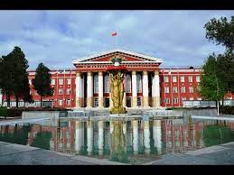
Osh State University College of International Education Programs

Slide 2
Abytova Aidana Srazhidinovna
ENGLISH TEACHER

Slide 3
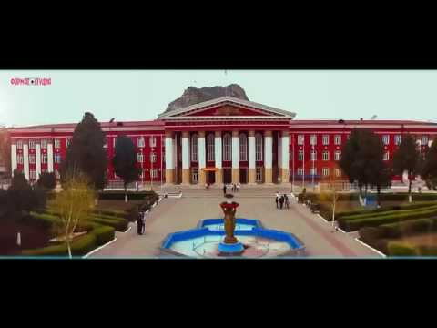
Date of birth:24.03.1998
Citizenship : Kyrgyzstan
Nationality: kyrgyz
Telephones:+996500649193
Home address: Osh city.Ashymahunov 42/65
e-mail:aydana_abytova@gmail.com

Slide 4
Education
2016/2020 Osh state University(bachelor degree) The Faculty of World Languages and Cultures
2020/2022 Osh state University(master degree) The Faculty of World Languages and Cultures
WORK EXPERIENCE
2020-2022 Office registrator
2022-The teacher

Slide 5
