Slide 1
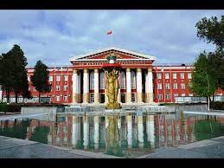
Osh State University College of International Education Programs

Slide 2
Erkebaeva Zhypar Chyrmashevna
ENGLISH TEACHER

Slide 3
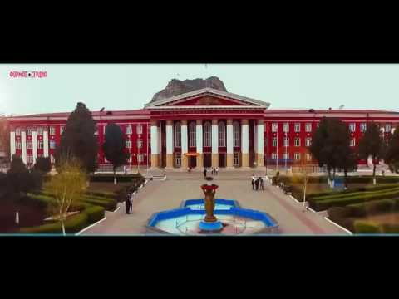
NATIONALITY - KYRGYZ
CITIZENSHIP - KR
PLACE OF WORK: OSH STATE UNIVERSITY
POSITION: LECTURER AT THE DEPARTMENT OF TRANSLATOR
WORK EXPERIENCE - 14
DATE AND PLACE OF BIRTH - 02.12.1970, OSHSITY, UZGEN DISTRICT, KYZYL-DYIKAN VILLAGE
EXPERIENCEIN OSHSU – 14
MOBILE PHONE:+996770323206
E-MAIL.mail:ahunzhanova.j78@mail.com

Slide 4
Date of birth: 21.03.1978
Citizenship : Kyrgyzstan
Nationality: Kyrgyz
Telephones: : +996 556 22 28 46
Home address: Osh/ Petrova 33/29
e-mail:
zyparerkebaeva682@gmail.com

Slide 5
Education
1996-2002 OshSU The Faculty of foreign Languages
Work Experience
2003-2012 English teacher OshTU Department of management and foreign affairs, сhair of "Translation and translation studies"
2019-2020 English teacher KUU chare of " Foreign languages“
2020-2022 English teacher OshSu KIEP

