Slide 1
Osh State University College of International Education Programs

Slide 2
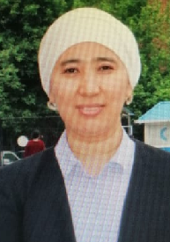
Aitkulova ZHazgul Nurkamilovna
ENGLISH TEACHER

Slide 3
Date of birth: 22.04.1985
Citizenship : Kyrgyzstan
Nationality: kyrgyz
Telephones:+996772945707
Home address: Osh city. Anar 17/5
e-mail:aitkulovaJ@mail.com

Slide 4
EDUCATION
2001-2006 OshSU Faculty of World Langusges and Cultures, Specialization "Foreign Language"
WORK EXPERIENCE
2006-2007 English teacher OshSu Faculty of World Languages and Cultures
2007-2018 №1 English teacher of the Secondary School named after Zh.Abdrasulova
2019-the teacher of the International Educational Programs College (OshSU)

Slide 6
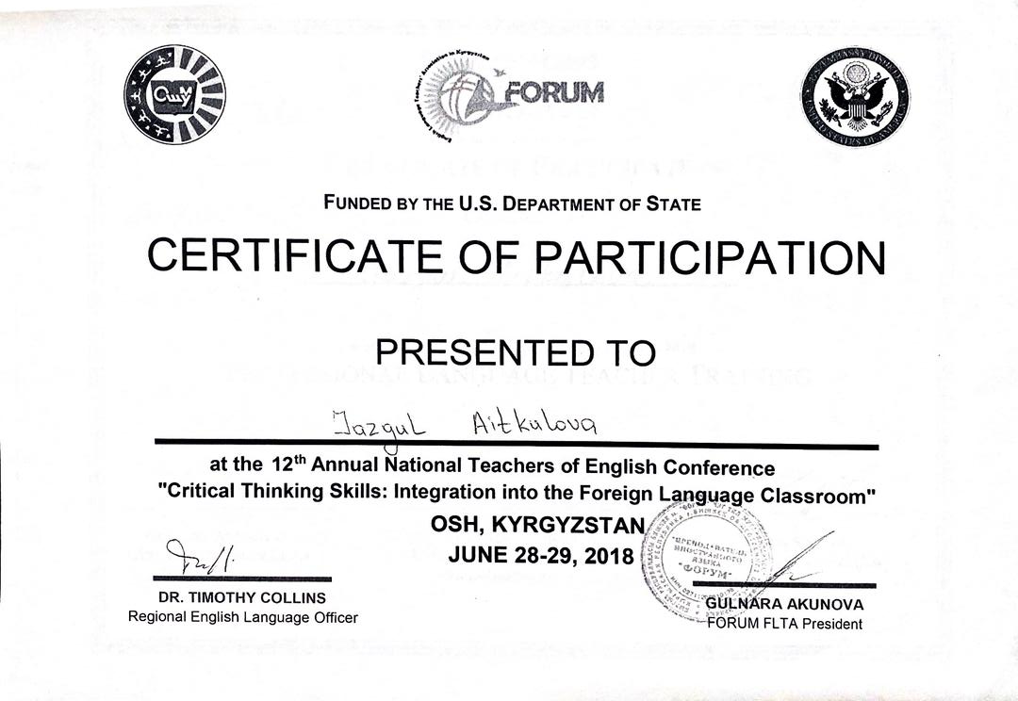
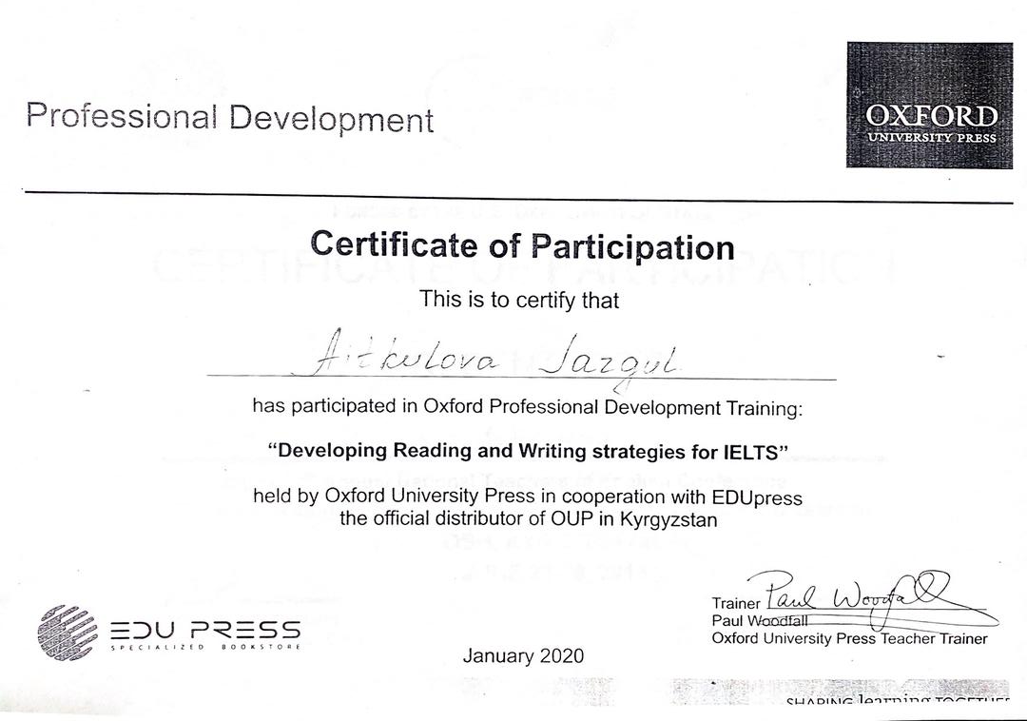

Slide 7
