Slide 1
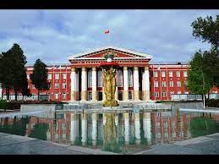
Osh State University College of International Education Programs

Slide 2
IMAR KYZY GULDANA
ENGLISH TEACHER

Slide 3
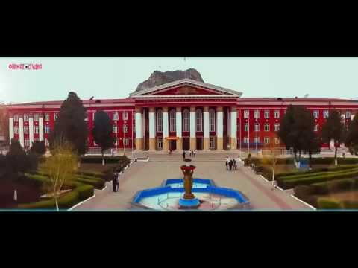
Date of brith:17.02.1997
Citizenship : Kyrgyzstan
Nationality: kyrgyz
Telephones:+996707138677
Home Osh/Zhapalak/Tashieva20
e-mail:guldan.97kg@gmail.com

Slide 4
EDUCATION
2015 - 2019 OshSU Faculty of World Langusges and Cultures
WORK EXPERIENCE
2020- 2021 English teacher
OshSU IMF OshSU CIEP

