Slide 1
This part of presentation is designed to present some important points of survey on online teaching practice ….

Slide 2
This survey explore opinions on online school internship and attracted a record number of 180 students 66% were students from regions.

Slide 3
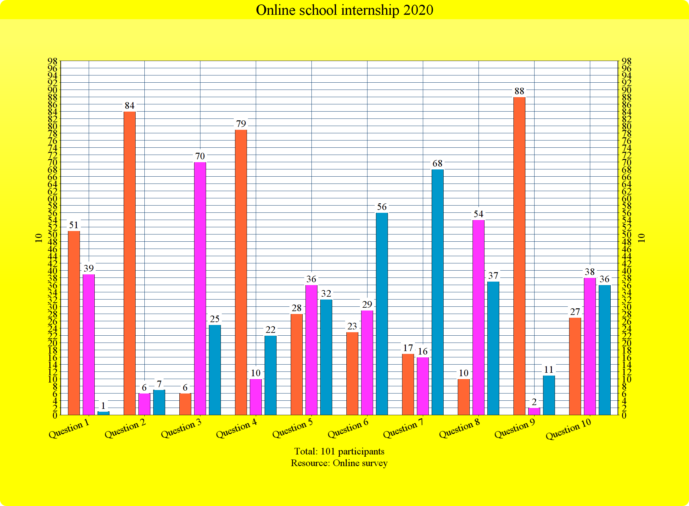

Slide 4
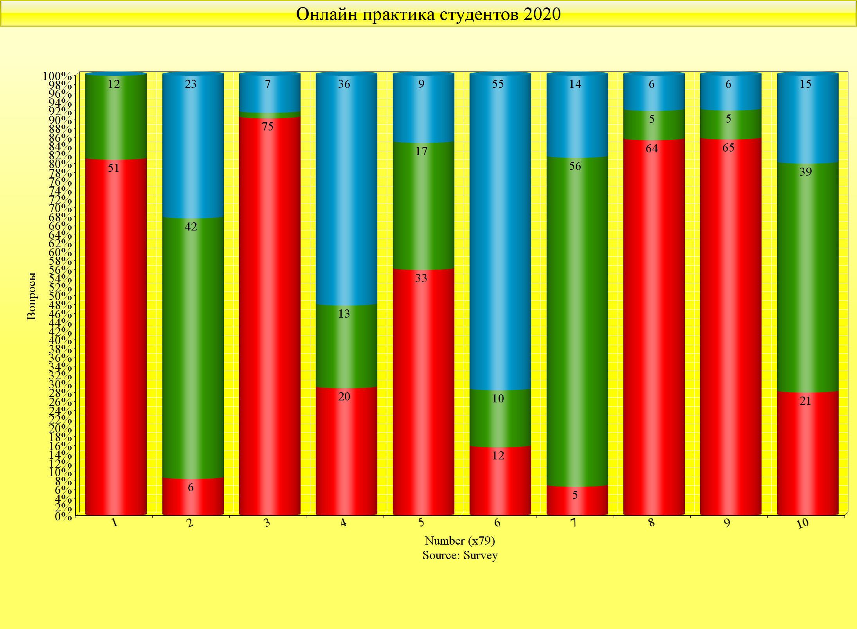
Online school internship 20 20 pedagogical practice

