Slide 1
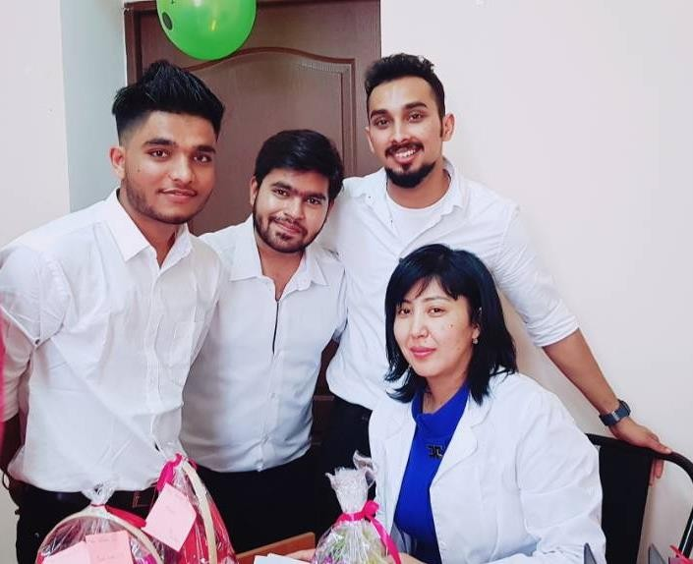
Aizirek Topchubaevna Satybaldieva
Instructor of the department «Clinical disciplines 3».
in IMF of OshSU

Slide 2
PERSONAL INFORMATION
Born in 25.06. 1980 year, kyrgyz.
In 2003 s graduated from OshSU, Faculty of Medicine, "General Medicine".
General experience of 18 years.
The total experience of teaching work is 7 years.
The general scientific and pedagogical experience at OshSU 4 full years.
2015 – 2021 assistant of department «Public health» in IMF of OshSU.
Field of professional activity: «Community medicine», «Public health».
Field of professional activity: General therapy.
From- 2021 teacher of department “Clinical disciplines” in OshSU.
My hobbies :play volleyball, swimming.

Slide 3
Key qualifications
2006-Advanced training in the specialty "Family doctor«
2007- FMC "Medigos« The best specialist»
2010-Advanced training in the specialty of a doctor of the second category
2015-Advanced training in "Pedagogy and Psychology"
2019-Certificate for the program "Basic aspects of phthisiology" in the volume of 150 hours 2021Advanced training in "Pedagogy and Psychology"
2021-"Modern tools and services for the implementation of e-learning technologies"

Slide 4
Work experience
2005-2010-FMC "Medigos" therapist, family doctor
2010 - 2015- FMC No-1, FTSM No.-3 therapist, family doctor, specialist
in HIV patients.
2016 - Lecturer at Osh State University International Medical Faculty of the Department"" Subjects "Social medicine", "Microbiology", "Public health». Curator at the department.
2019 – assistant of the department of Сlinical disciplines 2 in the International Medical Faculty of OshSU.
From 2021 of the department of Сlinical disciplines 3 in the International Medical Faculty of OshSU.

Slide 5
Working with students

Slide 6
Contact information
Phone number: +996 774601041
E-mail: rahmanali040206@gmail.com

