Slide 1
THEORETICAL GRAMMAR
Lecture 1

Slide 2
Grammar: the origin of the term
The term grammar is derived from the Greek word grammatikē, where gram meant something written. The part tikē derives from technē and meant art.
Hence grammatikē is the art of writing.

Slide 3
GRAMMAR
PRACTICAL GRAMMAR
THEORETICAL GRAMMAR

Slide 4
Theoretical and Practical Grammar
Practical grammar gives practical rules of the use of linguistic structures.
Theoretical grammar gives an analysis of the structures in the light of general principles of linguistics and the existing schools and approaches.

Slide 5
THE AIM OF THEORETICAL GRAMMAR
Any course of theoretical grammar today serves to describe the grammatical structure of language as a system where all parts are interconnected.

Slide 6
THEORETICAL GRAMMAR
DESCRIPTIVE GRAMMAR
PRACTICAL GRAMMAR
PRESCRIPTIVE GRAMMAR

Slide 7
Prescriptive and Descriptive Grammar
Practical grammar prescribes certain rules of usage and teaches to speak or write correctly.
Theoretical grammar presents facts of language while analyzing them and gives no prescriptions.
To a prescriptive grammarian, grammar is rules of correct usage; its aim is to prescribe what is judged to be correct rather than to describe actual usage.
To a descriptive grammarian (descriptivist), grammar is a systematic description of the structure of a language.

Slide 8
Historical Types of Grammars
traditional (prescriptive and non-structural descriptive)
structural descriptive
transformational-generative

Slide 9
Pāṇini (4th century BCE) is known for his Sanskrit grammar, particularly for his formulation of the 3,959 rules of Sanskrit morphology, syntax and semantics, in the grammar known as Aṣṭādhyāyī, meaning "eight chapters".
His theory of morphological analysis was more advanced than any equivalent Western theory before the mid 20th century.

Slide 10
A 17th century birch bark manuscript of Panini’s grammar treatise from Kashmir

Slide 11
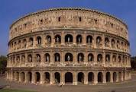
In ancient Greece and ancient Rome the term ‘grammar’ denoted the whole apparatus of literary study.

Slide 12
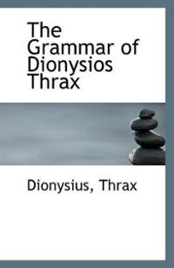
Traditional Grammar in Ancient Greece
Traditional grammar has its origins in the principles formulated by the scholars of Ancient Greece – in the works of Dionysius Thrax, Protagoras, Plato, and Aristotle.
Dionysius Thrax (c. 100 BCE)
was the first to present a
comprehensive grammar of Greek.
His grammar remained a
standard work for thirteen centuries.

Slide 13
Thrax’s Grammar
Thrax distinguishes two basic units of description – the sentence (logos), which is the upper limit of grammatical description, and the word, which is the minimal unit of grammatical description.
The sentence is defined notionally as “expressing a complete thought”.

Slide 14
Constituents of the sentence (class words)
onoma (noun)
rhema (verb)
metochē (participle)
arthron (article)
antonymia (pronoun)
próthesis (preposition)
epirrhēma (adverb
syndesmos (conjunctions)

Slide 15
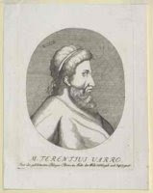
Traditional Grammar in Ancient Rome
The first Latin grammar was written by Varro (116–27 B.C.). One of Varro’s merits is the distinction between derivation and inflection. Varro set up the following system of four inflexionally contrasting classes:
1) those with case inflexion (nouns
including adjectives);
2) those with tense inflexion (verbs);
3) those with case and tense inflexion
(participles);
4) those with neither (adverb).

Slide 16
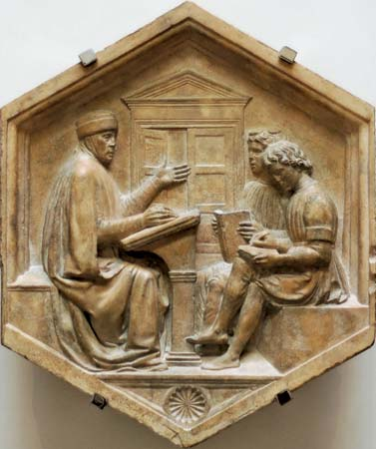
From Antiquity to the Present Day
The Latin grammars of the present
day are the direct descendants of
the works written by late
grammarians, Priscian (c. A.D. 500)
in particular.
Their aim was to transfer as far as
possible the grammatical system of
Thrax’s grammar.

Slide 17
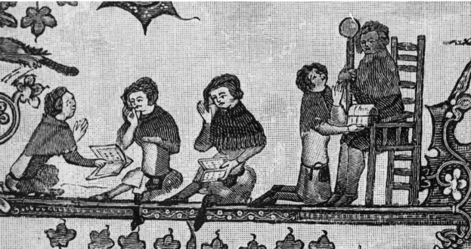
In the middle ages, grammar was the study of Latin.

Slide 18
Latin Grammars in English Schools
Until the end of the sixteenth century, the only grammars used in English schools were Latin grammars.
The aim was to teach the English to read, write and sometimes converse in this lingua franca of Western Europe.

Slide 19
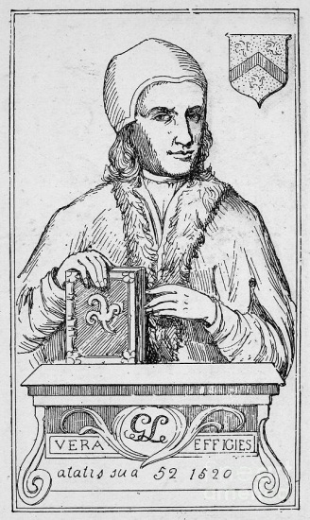
One of the earliest and most popular Latin grammars written in English was William Lily’s grammar, published in the first half of the 16th century. It was an aid to learning Latin, and it rigorously followed Latin models.

Slide 20
Early English Grammars
The Renaissance widened linguistic horizons. Scholars turned their attention to the living languages of Europe.
Although the study of Greek and Latin grammar continued, they were not the only languages scholars became interested in.
The first grammars of English were closely related to Latin, which scholars had treated as an ideal language.
English, which replaced Latin, had to appear as perfect as Latin. As a result, some English scholars were greatly concerned with refining their language. Through the use of logic they hoped to improve English.

Slide 21
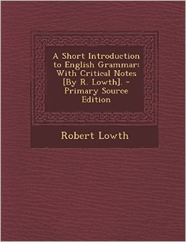
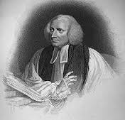
The First English Grammar
The first grammars of English were prescriptive, not descriptive.
The most influential grammar of this period was R.Lowth’s Short Introduction to English Grammar (1762).

Slide 22
English described through Latin
The aim of this grammar was “to teach us to express ourselves with propriety ... and to enable us to judge of every phrase and form of construction, whether it be right or not”.
The criterion for the discrimination between right and wrong constructions was Latin.
As Latin appeared to conform best to their concept of ideal grammar, English was described in terms of Latin forms and the same grammatical constraints were imposed.
E.g,, a noun was presented in the form of the Latin noun paradigm:
Nominative: the house Genitive: of the house Dative: to the house Accusative: the house Ablative: in, at, from the house Vocative: house

Slide 23
The Features of Prescriptive Grammar
To sum up, early prescriptive grammar could be characterized by the following features:
1) patterning after Latin in classifying words into word classes and establishing grammatical categories;
2) reliance on meaning and function in definitions;
3) approach to correctness: the standards of correctness are logic, which was identified with Latin past;
4) emphasis on writing rather than speech.

Slide 24
Descriptive (non-structural) grammar

Slide 25
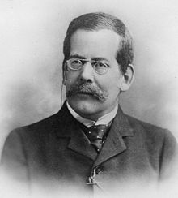
Non-Structural Descriptive Grammar
Henry Sweet (1845–1912), “New English
Grammar, Logical and Historical “(1891):
“ As my exposition claims to be scientific,
I confine myself to the statement of facts, without attempting to settle the relative correctness of divergent usages. If an ‘ungrammatical’ expression such as it is ‘me’ is in general use among educated people, I accept it as such, simply adding that it is avoided in the literary language.”

Slide 26
Non-Structural Descriptive Grammar in Summary
Unlike prescriptivists, descriptivists focus their attention on actual usage without trying “to settle the relative correctness of divergent usages.”
Similar to prescriptivists, descriptivists use meaning and function in their definition of parts of speech.

Slide 27
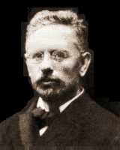
Otto Jespersen (1860–1943), a Danish linguist, developed the theory of grammar and the grammar of English. He proposes three principles of classification – meaning, form, and function. His theory is set out in “The Philosophy of Grammar” (1924).
It removes the parts of speech from the syntax, is based on the concepts of ranks and brings the concept of context to the forefront of the attention.

Slide 28
The Emergence of Structuralism

Slide 30
As a reaction to the atomistic approach to language a new theory appeared that was seeking to grasp linguistic events in their mutual interconnection and interdependence, to understand and to describe language as a system.

Slide 31
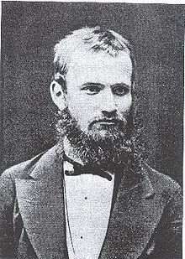
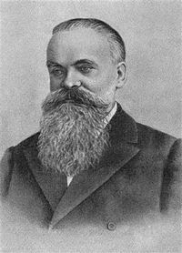
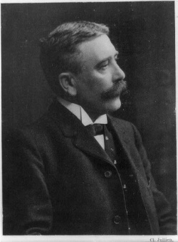
The first linguists to speak of language as a system or a structure of smaller systems were Beaudouin de Courtenay (1845-1929) and F.F.Fortunatov (1848-1914) of Russia, and the Swiss linguist Ferdinand de Saussure (1857-1913).

Slide 32
The American Descriptive School

Slide 33
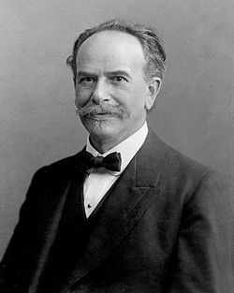
Frantz Boas, linguist and anthropologist (1858-1942) is usually mentioned as the predecessor of American Descriptivism.
His basic ideas were later developed by Edward Sapir (1884-1939) and Leonard Bloomfield (1887-1949).

Slide 34
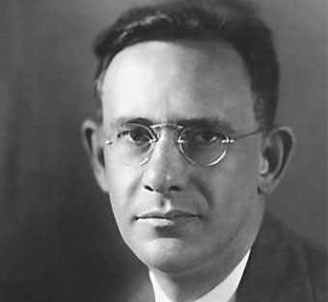
Leonard Bloomfield:
”The study of language can be conducted...only so long as we pay no attention to the meaning of what is spoken” (“Language”,1933).

Slide 35
The American Descriptive School
The principal approach: to study the structure of a language as objectively as possible, without reference to meaning and other languages
The analysis of sentences collected from native speakers of the language, giving preference to spoken language
The focus: to devise formal methods of analysis and replace meaning by form; interest in what is observes, i.e. objective data

Slide 37
The chief contribution of the American Descriptive School to modern linguistics is the elaboration of the techniques of linguistic analysis.

Slide 38
The Descriptivist Methods
The main methods are
(1) the Distributional Method and
(2) the Method of Immediate Constituents.

Slide 39
The Distributional Analysis
is a method of linguistic research in which the classification of linguistic units and the study of their features are carried out on the basis of the distribution of the units in question in the spoken chain, i.e. on the basis of their combinability.

Slide 40
The combinability (environment, context)
Context
(unit 1)
Unit
in question
Context
(unit 2)

Slide 41
Distributional hypothesis
Linguistic units with similar distributions have similar meanings.

Slide 42
2. The Method of Immediate Constituents
The term immediate constituents (IC) was introduced by L. Bloomfield as follows: “Any English-speaking person who concerns himself with this matter is sure to tell us that the immediate constituents of
Poor John ran away
are the two forms Poor John and ran away; that each of these is, in turn, a complex form; that the immediate constituents of ran away are ran and away, and that the constituents of Poor John are poor and John”.

Slide 43
Immediate Constituents
Poor John ran away
Poor
John
ran away
ran
away
Poor John

Slide 44
2. The Method of Immediate Constituents
This method is based on the binary principle, i.e. each stage of the procedure involves two components the unit immediately breaks into.
The analysis is completed when we arrive at constituents incapable of further division.

Slide 45
DEFINITIONS for the Method of Immediate Constituents

Slide 46
Definition 1
An immediate constituent is a word or a group of words that functions as a single unit within a hierarchical structure.

Slide 47
Definition 2
The ultimate constituents are the smallest meaningful units which any given construction can be broken down to, consisting of a morpheme at the morphological level and a word at the syntactic level.

Slide 48
Definition 3
The linguistics procedure which divides sentences into their component parts or constituents in this way is known as constituent analysis.

Slide 49
Definition 4
The segmentation of the sentence into its immediate constituents by using binary cuttings until its ultimate constituents are obtained is called Immediate Constituent Analysis (IC Analysis).

Slide 50
TRANSFORMATIONAL AGRAMMAR

Slide 51
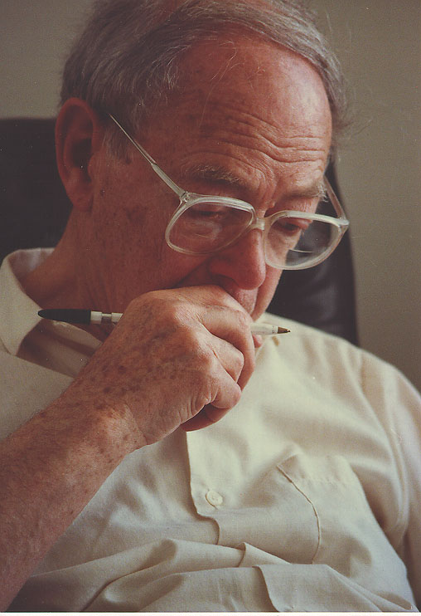
The idea of the Transformational Grammar (TG) was first suggested by Zellig S.Harris as a method of analyzing the “raw material” (concrete utterances) and was later(1957) elaborated by Noam Chomsky as a synthetic method of “generating” (constructing) sentences.

Slide 52
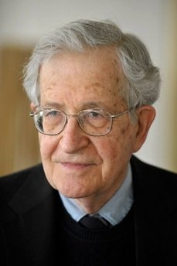
Noam Chomsky
TG is a system of grammatical
analysis that uses transformations
to express the relations between
elements in a sentence, clause, or
phrase, or between different forms
of a word, phrase, etc., as between
the passive and active forms of a verb.

Slide 53
TG refers to syntax and presupposes the recognition (identification) of such linguistic units as phonemes, morphemes and form-classes, the latter being stated according to the distributional and the IC-analysis or otherwise.

Slide 54
According to Chomsky, the central goal of linguistic theory is to determine what it is that people know if they know a particular language.

Slide 55
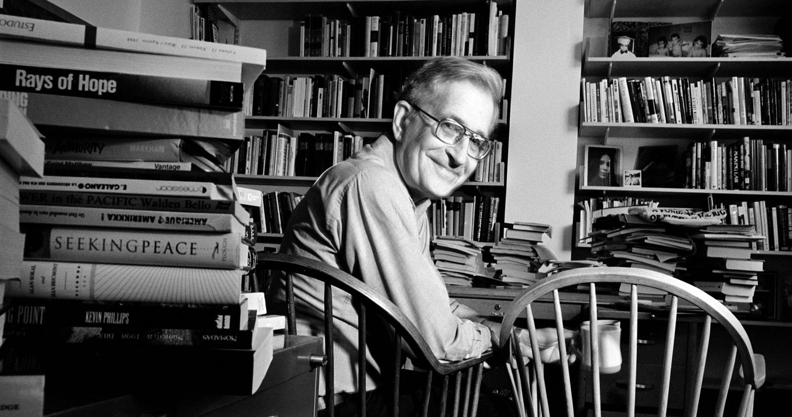
Кnowing a language involves having the ability to produce and understand an unlimited number of utterances of that language that one may never have heard or produced before.

Slide 56
А GM is a system of explicit rules that may apply recursively to generate an indefinite number of sentences that can be as long as you want them to be.
John saw the picture of the baby on the table in the attic.
S-sentence, N-noun, NP-noun phrase, V-verb, VP-verb phrase, P-preposition, PP-prepositional phrase, DP-determiner phrase, DET-determiner.

Slide 58
In generative linguistics 'grammar' refers to the implicit, totally unarticulated knowledge of rules and principles of the language that people have in their heads.
This tacit knowledge enables them to distinguish between well-formed and ill-formed words and utterances in their language, e.g. it’s correct to say a grain but 'incorrect' to say *a oat.

Slide 59
In generative linguistics the term 'grammar' covers not only morphology and syntax but also semantics, the lexicon and phonology.
Phonological rules, morphological rules, syntactic rules and semantic rules are all regarded as rules of grammar.

Slide 60
Chomsky has shifted the focus of linguistic theory from the study of observed behaviour to the investigation of the knowledge that underlies that behaviour.
In generative linguistics, rules are intended to go beyond accounting for patterns in the data to a characterisation of speakers' linguistic knowledge.
The primary objective of generative grammar is to model a speaker's linguistic knowledge.

Slide 61
Chomsky characterises linguistic knowledge using the concepts of competence and performance.

Slide 62
Competence is a person's implicit knowledge of the rules of a language that makes the production and understanding of an indefinitely large number of new utterances possible. Performance is the actual use of language in real situations.
LINGUISTIC KNOWLEDGE
COMPETENCE
PERFORMANCE

Slide 63
Chomsky proposes that competence, rather than performance, is the primary object of linguistic inquiry.

Slide 64
Chomsky contends that the linguistic capacity of humans is innate. The general character of linguistic knowledge is determined by the nature of the mind, which has a specialized language faculty.
This faculty is determined in turn by the biology of the brain. The human child is born with a blueprint of language that is called Universal Grammar.

Slide 66
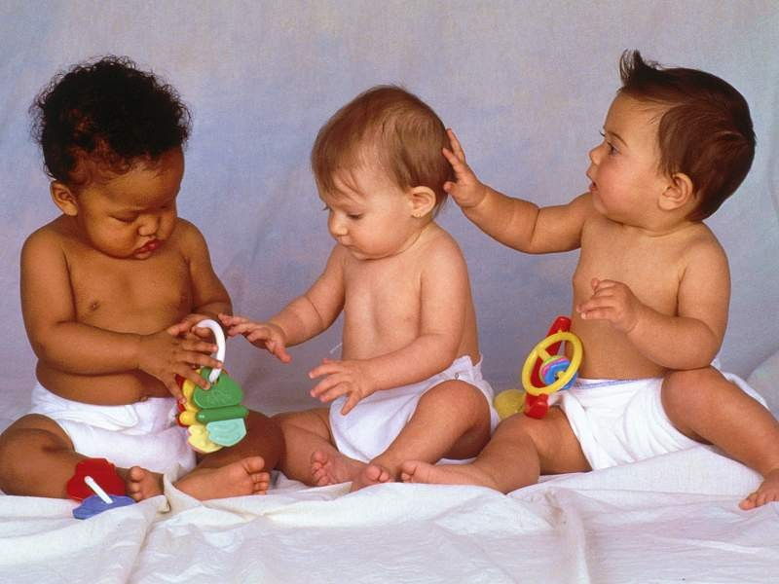
According to Chomsky, Universal Grammar is the faculty of the mind that determines the nature of language acquisition in the infant and of linguistic competence.

Slide 68
The properties that lie behind the competence of speakers of various languages are governed by restricted and unified elementary principles rooted in Universal Grammar.

Slide 70
This explains the striking similarity between languages in their essential structural properties. The structural differences between languages occur within the range sanctioned by Universal Grammar.

Slide 72
TEST 1
1. The method based on the binary principle, which breaks each unit into two components, is called the
distributional analysis
method of immediate constituents
descriptive method
method of structural oppositions
2. Panini wrote one of the first grammars of
Latin
Ancient Greek
Sanskrit
Old Italian

Slide 73
3-5. Add one word into each gap. The first letter is given:
Practical grammar (3) p__________ certain rules of usage and teaches to speak or write correctly rather than to describe actual usage. (4) T_____________ grammar presents facts of language while analyzing them and gives no prescriptions. To a (5) d___________ grammarian, grammar is a systematic account of the structure of a language.

Slide 74
6. Show the chronological order in which the four great grammarians of the past lived and worked (1 - the earliest one, …, 4 – the latest one):
Varro -
Lily –
Thrax –
Priscian -

Slide 75
7. Choose as many possible correct answers as necessary: In the distributional analysis the classification and the study of linguistic units are carried out on the basis of their distribution in the spoken chain, i.e. on the basis of their _______________.
combinability
addition
environment
context

Slide 76
8. According to Chomsky, the central goal of linguistic theory is to determine
what the difference between competence is performance is.
what it is that people know if they know a particular language.
how languages differ from one another.
what methods are used in linguistic research.

Slide 77
9. According to Chomsky, the linguistic capacity of humans is
innate.
determined by the nature of the mind, which has a specialized language faculty.
called Universal Grammar.
dependent on the grammar of the specific language the child is exposed to.

