Slide 1
Portfolio
Hello everyone!
I’m Aziza Seitova,
I’m Senior Lecturer of Basic Pharmacology at IMF OshSU
My motto is: “Docendo discimus”
-Seneca the Younger

Slide 2
About me
I was born and raised in the beautiful city of Osh, famous for its ancient history.
Graduated from the Medical Faculty of Osh State University in 2015
I am currently working a full time position focusing on basic pharmacology at International Medical Faculty of Osh State University.
I am eager to continue enhancing my knowledge about this industry, and am excited to see what the future holds!

Slide 3
Course and Lesson Planning “Tell me and I forget, teach me and I may remember, involve me and I learn.” - Benjamin Franklin
When I first started as an instructor in fall 2015, I met with individuals who previously taught the course and developed my syllabus and notes based on their materials. Over the last few years, I've made adjustments to the course structure based on trial and error and student feedback..
A sample of lesson plans and my fall 2020 course syllabus are provided to the right. These documents showcase how I use the tools, methods, and experience to aid learners.
Syllabus on Basic Pharmacology
Lesson Plan Basic Pharmacology

Slide 4
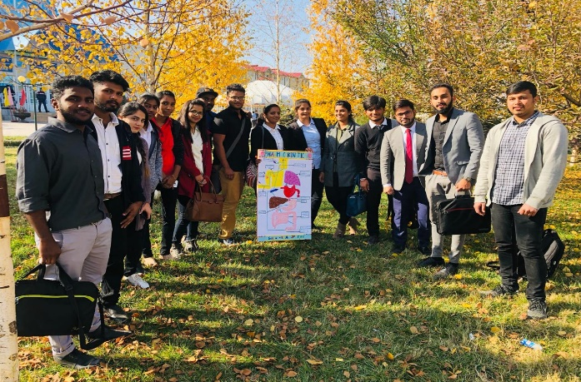
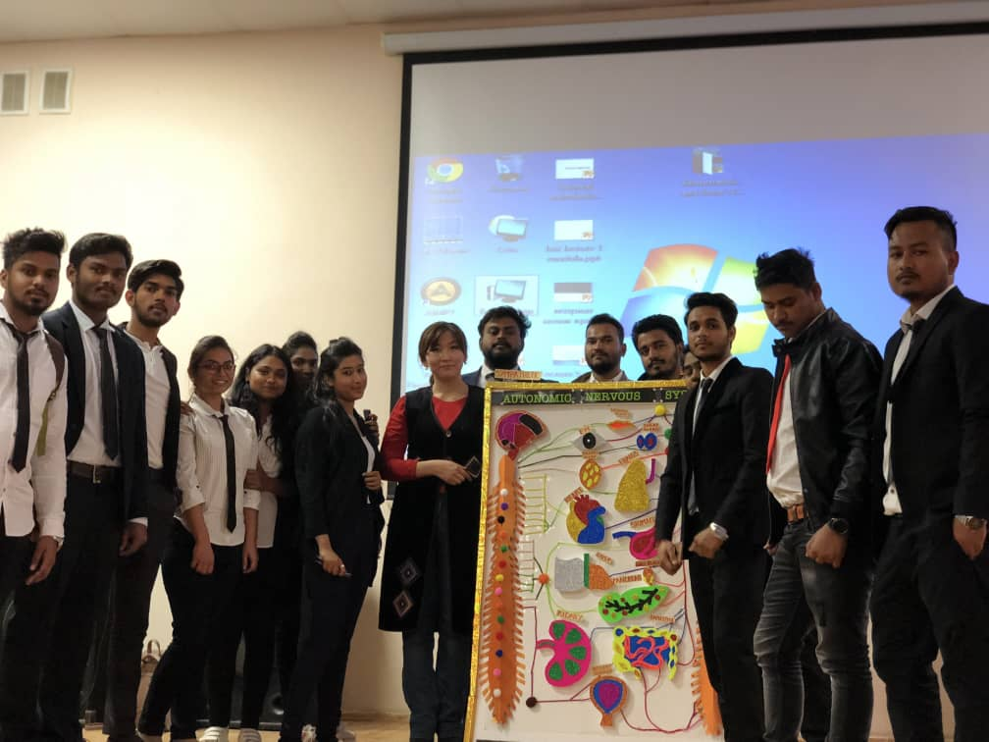
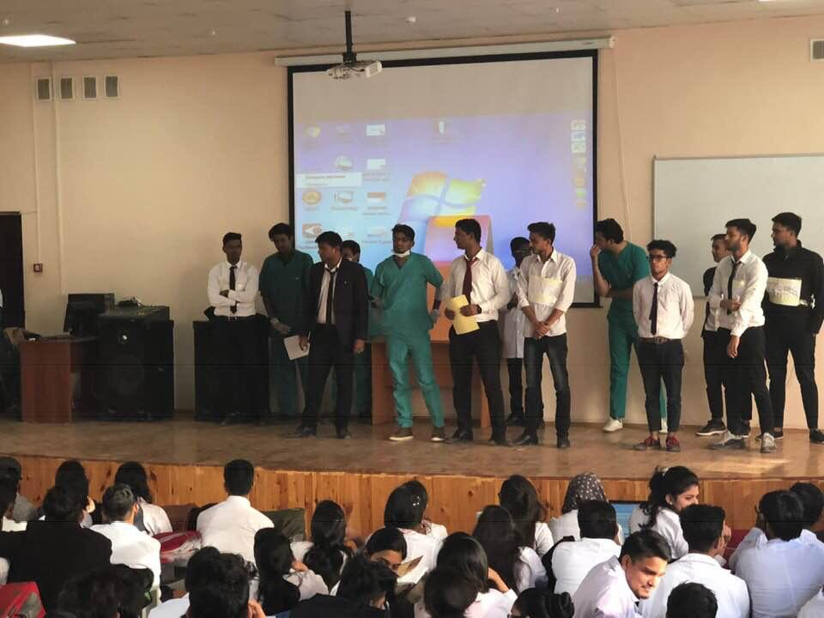
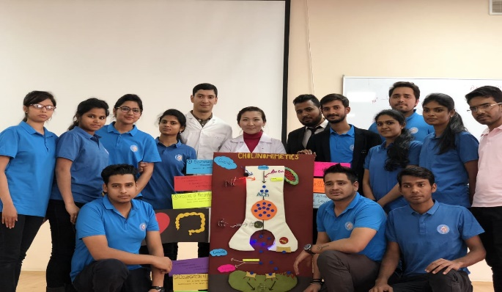
Achievements of my students
Every semester, Olympiads are held in the discipline. students take an active part and those who receive prizes are rewarded with additional points

Slide 5
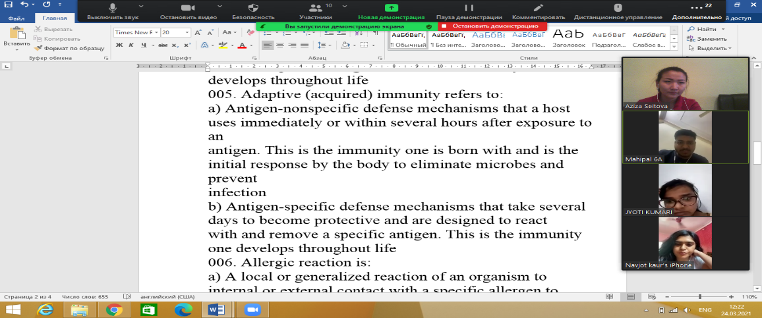
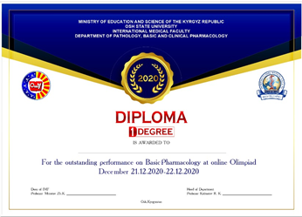
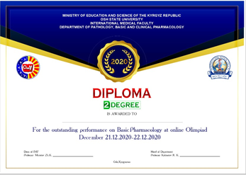
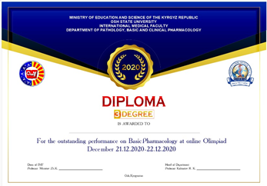
Achievements of my students
the Olympiads were also held in an online format

Slide 6
Research “Research is formalized curiosity. It is poking and prying with a purpose.” - Zora Neale Hurston
One of the most important parts of my graduate studies is research.
Being a researcher requires me to search for further information, and know when to ask for help from my advisor and other peers and faculty. Being able to take what is known and apply it to a problem or use theorems to set standards is one of the main reasons I love my work.
Read more about my articles by clicking on the links below
e-library
Web of Science

Slide 7
Contact
Occupation: International Medical Faculty, Osh State University
Address: Vodozabornaya str. b/n
ORCID: https://orcid.org/0000-0002-7138-545X
E-mail: azizaseit26@gmail.com
aseitova@oshsu.kg
Curriculum Vitae

