Slide 1
What do you like?
Урок английского языка из УМК «Практический курс основного иностранного языка»
Автор: Акимжан кызы Мээрим
КМОП Переводческое дело: «Английский язык»

Slide 2
Object Pronouns
I – я
me – мне, меня
he – он
him – его, ему
she – она
her – её, ей
it – оно, это
it – это, его
we – мы
us – нас, нам
you – ты, вы
you – тебе, вам
they – они
them – их, им

Slide 3
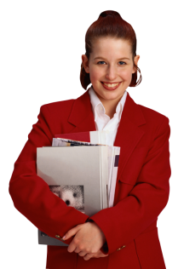
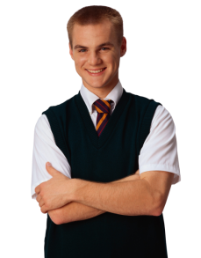
Fill in the gaps
1. This is my brother. Do you know _____ ?
2. This is my sister. Do you know _____ ?
him
her

Slide 4
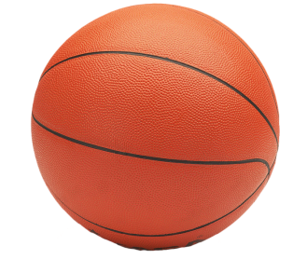
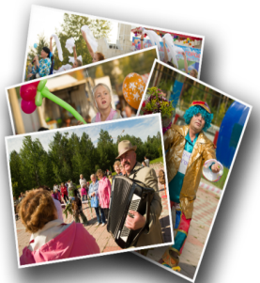
Fill in the gaps
3. This is my new basketball. Do you like ____ ?
4. These are my pictures. Do you like ____ ?
it
them

Slide 5
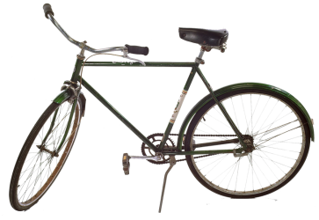
Fill in the gaps
5. This is my new bicycle. Do you like ____ ?
6. My bags are heavy. Can you help _____ ?
it
me

Slide 6
Expressing likes/dislikes
Stage 1
Stage 2
Stage 4
Stage 3
I love it.
I like it.
I don’t mind it.
I hate it.

Slide 7
Adjectives
Positive +
Negative -
horrible
enjoyable
dull
delicious
awful
exciting
great
wonderful
disgusting
terrible
boring
fine

Slide 8
Find the opposites:
boring
horrible
love
disgusting
awful
fantastic
hate
terrible
nice
interesting
wonderful
delicious

Slide 9
Do the puzzle
i
n
t
e
r
e
s
t
i
n
g
Pop concerts are …
My brother thinks skiing is… .
She doesn’t like football. She finds it … .
That’s a … idea!
Paul thinks camping is … .
Tony doesn’t like chicken. He thinks it … .
I love games. They’re …
f
a
n
t
a
s
t
i
c
b
o
r
i
n
g
g
r
e
a
t
d
u
l
l
a
w
f
u
l
e
x
c
i
t
i
n
g
Q
W
E
R
T
Y
U
I
O
P
-
A
S
D
F
G
H
J
K
L
Z
X
C
V
B
N
M

Slide 10
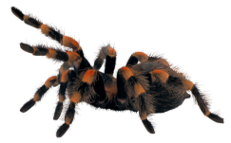
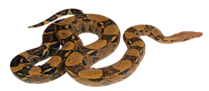
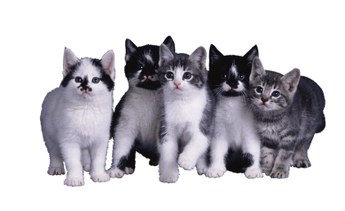
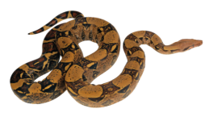
Answer the questions
Do you like spiders ?
Do you like snakes ?
Do you like cats ?

Slide 11
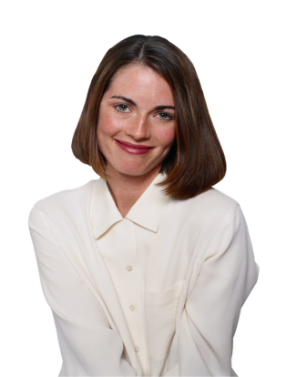
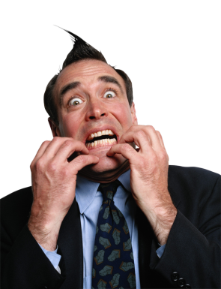
Answer the questions
What do you think
of this woman?
What do you think
of this man?

Slide 12
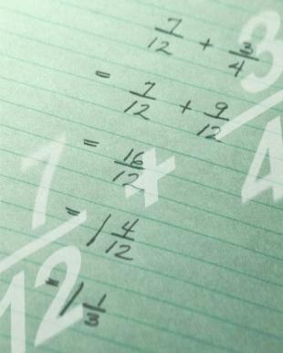
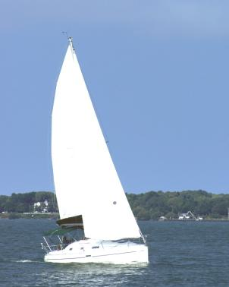
Answer the questions
What do you think
of this boat?
What do you think
of Maths?

Slide 13
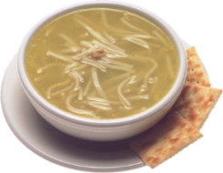
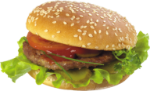
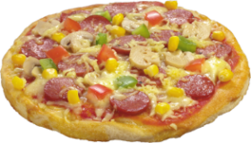
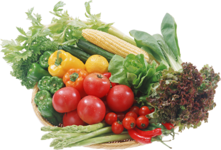
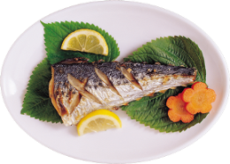
What is your favourite food?
hamburgers
pizza
soup
awful
delicious
disgusting
tasty
vegetables
fish
milk

Slide 14
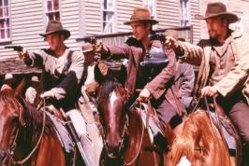
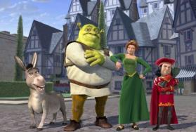
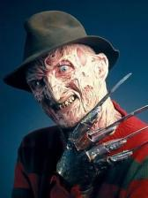
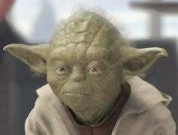
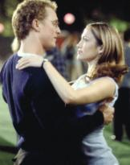
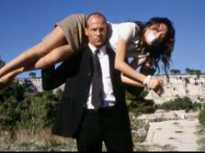
What is your favourite film?
western
cartoons
boring
exciting
terrible
wonderful
interesting
horror films
science fiction
action films
romance

Slide 15
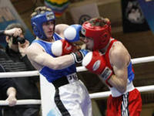
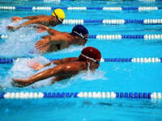
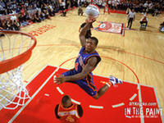
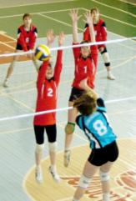
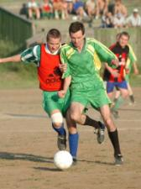
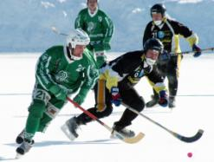
What is your favourite sport?
boxing
swimming
basketball
wonderful
exciting
dangerous
interesting
volleyball
football
ice hockey

Slide 16
Write a survey
50%
all of
none of
most of
few of
100%
0 %
some
All of my classmates …
Most of them …
Some …
Few of …
None of …

Slide 17
Match the sentences with the responses:
Are you free tonight?
Would you like to join me?
What about a pop concert?
How about a pizza?
I think so.
Count me in!
Pop music is not really my thing.
No, thanks.

Slide 18
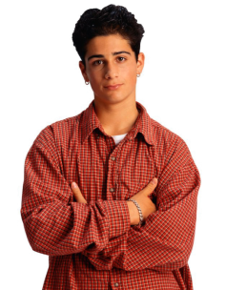
Your homework
p. 38 Ex. 6 Read the dialogue between Tony and David.
Where does Tony want to go with David tonight?
What does David suggest to do?

Slide 19
Information resources:
Solutions(Pre-Intermediate) students book

