Slide 1
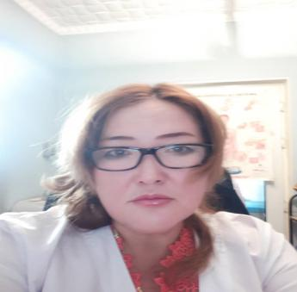
Subanova guljamal arstanalievna
Associate professor, candidate of medical science, Lecturer of the Department of "Clinical Disciplines 2" at the OSH State Medical University IMF

Slide 2
International Medical Faculty, Department of Clinical Disciplines 2
Subanova Gulzhamal Arstanalievna, born in 1967, Kyrgyz woman.
In 1994, she graduated with honors from the KSMU with a degree in medical science.
2015-2018-Law Institute, lawyer
Candidate of Medical Sciences since 2010.
She defended her dissertation on the topic "The use of microhydrin and carbonated mineral water (Kara-Shoro) in the rehabilitation treatment of cervical ectopia in women of reproductive age" on July 10, 2010 in the dissertation council. 14.05.275 at KRSU
Experience of teaching at universities – 18 years, including at Osh State University-18 years. General research and teaching experience – 18 full years.
The experience of the Law Firm KSMIP and PC is 7 years.
Field of professional activity: obstetrics and gynecology-27 years of experience.
Tel. 0772 230-519

Slide 3
Work experience
1987-94-Part-time nurse, Institute of Cardiology, Bishkek.
1994-99-obstetrician-gynecologist number 1 of the women's consultation Osh city
1999-2003-obstetrician-gynecologist of the MSPS Osh city
2003-2006-Teacher of the Department of Obstetrics and Gynecology of the Medical Faculty of Osh State University.
2006-2009-Senior lecturer of the Department of Obstetrics and Gynecology, OSH State University Medical Faculty
.From 2010 to the present-Associate Professor of the Department of Obstetrics and Gynecology of the Medical Faculty of OSH State University.
From January to June 2012-Acting, Associate Professor, Acting Head of the Department of Obstetrics and Gynecology of the Medical Faculty of OSH State University.
From September 2015 to the present-Associate Professor, Department of Clinical Disciplines, Faculty of Medicine, OSH State University.
From 2014 to 2018, the expert of the Results-based financing project of the Ministry of Health of the Kyrgyz Republic.

Slide 4
She developed educational work programs on specific topics and for in-depth study, test tasks, participated in various public events, spoke at various scientific and practical conferences among students, residents in universities in different countries. They took an active part in various state, international, and interregional projects, in particular the " Results-based financing " project of the Ministry of Health of the Kyrgyz Republic, were members of an expert group to assess the quality and standards of providing qualified medical, including obstetric, care to the population of remote regions of the Kyrgyz Republic. Lectures were given on the implementation of modern and approved by the Ministry of Health of the Kyrgyz Republic clinical protocols and the provision of practical assistance by the department staff in remote areas and regions of the Kyrgyz Republic.

Slide 5
certificates and awards
15.09-25.09.02
The certificate was issued for participation and scientific contribution to the work of the scientific conference Moscow Russia.
17.05. -25.05.05.
Certificate of completion of advanced training in "new horizons in endocrinology", Tashkent
14.06.99
The certificate was issued for completing the course " endocrinologists in obstetrics and gynecology, Osh, Kyrgyzstan.
09.11.07.
Certificate of the Foundation of Evidence-based medicine, Bishkek, Kyrgyzstan.
26.10. -28.10.05
Certificate for participation in the regional conference on accreditation of medical universities of the CAR, organized with the support of the AED/START USAID project, Almaty, Kazakhstan.
28.05-31.05.06
The certificate was issued for participation in the regional conference on accreditation of medical universities of the CAR, organized with the support of the AED/START USAID Project, Florida USA
May, 2008
Certificate for participation and scientific contribution to the IX Congress of the International Association of Morphologists (IAM) and the IV Congress of Morphologists of Uzbekistan, BSMI, Bukhara, Uzbekistan.
28.05.10
Diploma of the 1st degree "The best teacher of 2010.»

Slide 6
February, 2015
Certificate "Pedagogduk bilimin orkundotuu" kursunda bilimin zhogorulatuu boyuncha, OsMU, Osh, Kyrgyzstan.
30.06.10.
"excellent student of healthcare»MZKR
10.07.14.
Certificate ofHonor of the MZKR
22.02.16
MZKR certificate-emergency obstetric care
05/11/17
MZKR Certificate - Insertion and removal of IUD
04.06.18
Certificate of Completion the intermediate English Course
22/10/18
Certificate of ATTENDANCE Erasmus + staff mobility for teaching
11.10.2014
Certificate of Honor of OSH State University

Slide 7
22.12 15
Best Doctor of the Year * Kyrgyz tuusu newspaper
07.07.2017
Honorary Umay Mama of the Kyrgyz Republic* Association of Obstetricians-Gynecologists and Neonatologists
December 2018
Honor of the Gromat International Medical Facultyof OSH State University
06.03.2020
Badge "Kyrgyz kyraan kyzy", newspaper Kyrgyz tuusu
2020
Certificate of the Public Association of Obstetricians, Gynecologists and Perinatologists of Kyrgyzstan " New in the pathogenesis and treatment of polycystic ovary syndrome»

Slide 8
24.12.20
Certificate of Honor "For a great contribution to the protection of women's health of the population of the Kyrgyz Republic»
10.09.2020
Certificate "Modern methods of contraception", KSMIPiPK, Bishkek.
December 3, 2020
Certificate "Development of multiple choice test tasks", KSMIPiPK, Bishkek.
23.11.2020
Reference "New recommendations for the diagnosis and treatment of coronovirus infection COVID-19 protocol
February6, 2021
Certificate "System for improving the quality of services provided in Obstetric healthcare organizations(SNPC)»

Slide 12
Practical classes with 6th-year students

Slide 13
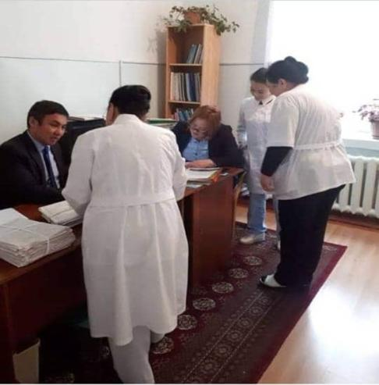
Project "Results-based financing" of the Ministry of Health of the Kyrgyz Republic, Expert assessment on improving the quality of work in maternity hospitals in Kyrgyzstan
Kara-Kulzhinsky maternity hospital, evaluation of the history of childbirth: Doctor of Medical Sciences Askerov A. A. and associate Professor Subanova G. A.

Slide 14
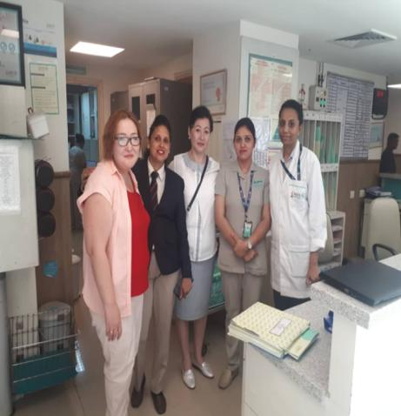
India, Delhi maternity hospital staff
Cooperation with the staff of the maternity hospital in Delhi, India, improving the provision of medical services, and the work of the educational system, further employment of our graduates

Slide 15
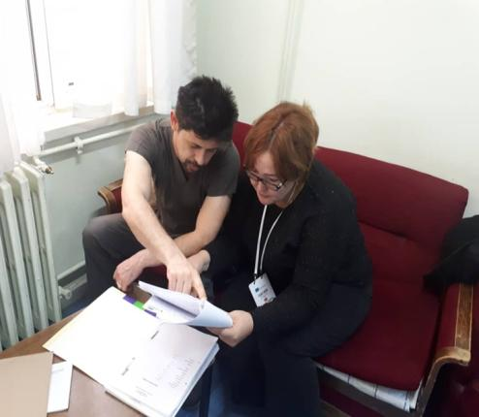
Turkey, Sivaz city, cumhuriyet University
doctor of the maternity hospital and associate professor of the department Subanova G. A., discussion of the partogram of childbirth, in the maternity hospital in Turkey.

