Slide 1
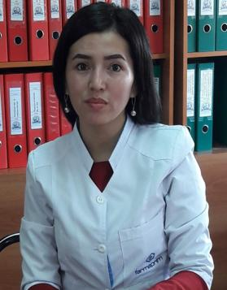
Tursunova Veronika Davidbekovna Instructor of Obstetrics & Gynecology of the department «Clinical disciplines 2» in IMF of OshSU

Slide 2
PERSONAL INFORMATION
Born in 1992 ,kyrgyz.
The experience of teaching at the university is 4 years in OshSU.
Field of professional activity: obstetrics & gynecology.

Slide 3
Education
1999 – 2010- Gymnasium High school “B. Osmonova”, Jalal-Abad city, Kyrgyzstan.
2010 – 2016- Medical faculty of Osh State University – graduated with red diploma with qualification – doctor of general medicine.
2016–2018 Osh Regional Maternity Hospital – passed 2 year of clinical residency, Faculty of Postgraduate Studies at the Osh State University with qualification – obstetrician – gynecologist.

Slide 4
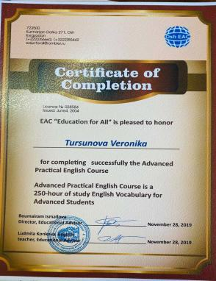
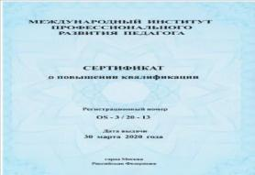
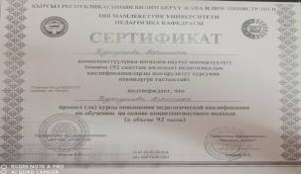
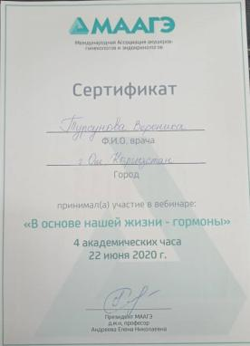
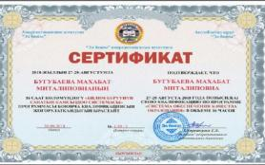
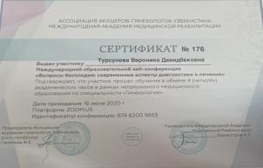
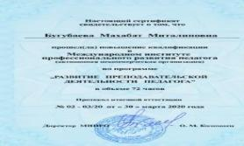
Advanced training

Slide 5
Work experience
2017-2018- methodist at the “Clinical disciplines 1” of IMF of OshSU
2018– 2019 - assistant – instructor at the Clinical Disciplines 2 of International Medical Faculty of OshSU.
From 09. 2019- instructor for obstetrics and gynecology at the Clinical Disciplines 2 of International Medical Faculty of OshSU.

Slide 6
Key qualifications
02.2019 | Certificate was issued for the course “Pedagogy and Psychology”, Osh State University , Osh, Kyrgyzstan.
05.2018 | Certificate for the Medical English Course at intermediate level, Osh
30.11.2018 | Certificate for participation in training “B-learning modules in occupational and environmental health”
28.08. 2018 | Certificate for advanced training in “Education quality assurance system”
25.09. 2019 | Certificate for participation in “Conducting a self-assessment of the university and writing a self-assessment report”
12.10.2019 | Certificate for participation in ‘Formation of learning outcomes and their role in the construction of the educational process”
22.06.2020 | Certificate for participation in vebinar «Hormones-the foundations of life
16.06.2020 | Certificate for participation in vebinar «Infertility issues: Modern aspects of diagnosis and treatment»
9.12. 2020 | Certificate for participation in international online-vebinar “PhD school”
,

Slide 7
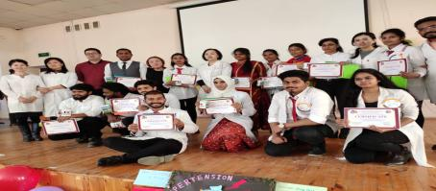
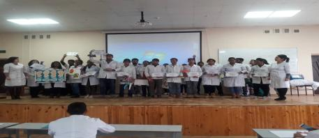
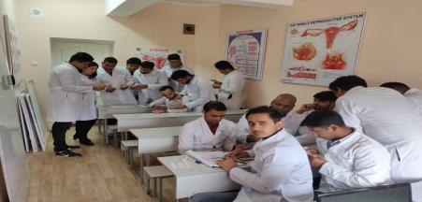
Working with students
,

Slide 8
Research
Publications
One of the most important parts of my graduate studies is research.
I am a PhD student at the Department of science and postgraduate study of the Osh State University from 29.12.2019 to present,
Being a researcher requires me to search for further information, and able to take what is known and apply it to a problem or use theorems to set standards is one of the main reasons I love my work.
Metodological instruction: «PRIMARY RESUSCITATION OF THE NEWBORN». Bugubaeva M. M., Djumaeva L. M., Omurzakova A. E., Tursunova V. D.
Article in journal of Scopus "Morphological characteristics of thymus in the newborns in different climatic and geographical conditions of Kyrgyzstan" в журнале: Scientific Research Publishing. Abaeva T., Muratov Zh., Tukhatshin R. , Abdullaeva Zh, Seitova A., Tursunova V.

Slide 9
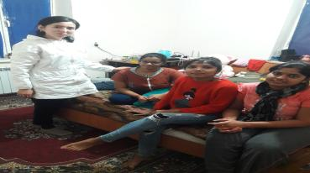
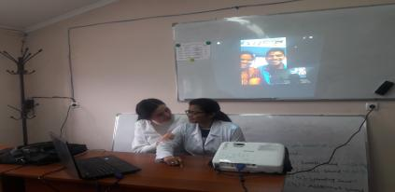
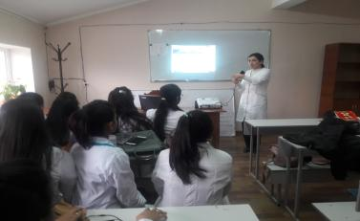
Curratorial work
,

Slide 10
Contact information
Phone number: +996 776 079 299
E-mail: tursunovvva1@mail.ru

