Slide 1
Portfolio
MD. Davran Toktonazarov
OBG Instructor at IMF OshSU

Slide 2
About me
Born in Osh city, Kyrgzystan.
Graduated the Medical Faculty of Osh State University in 2004
From 2004-2006 OBG residency in Osh state interregional hospital, maternity department.
Work experience; Medical Doctor at position in Maternity Department of Osh state interregional hospital from 2006-2019.
I am currently working a full time position on OBG Instructor at International Medical Faculty of Osh State University.

Slide 3
Education Plan
Share the knowledge with the students and teach students in an accessible language for them.
Use new education technology and methods.
Train high qualified specialists.

Slide 4
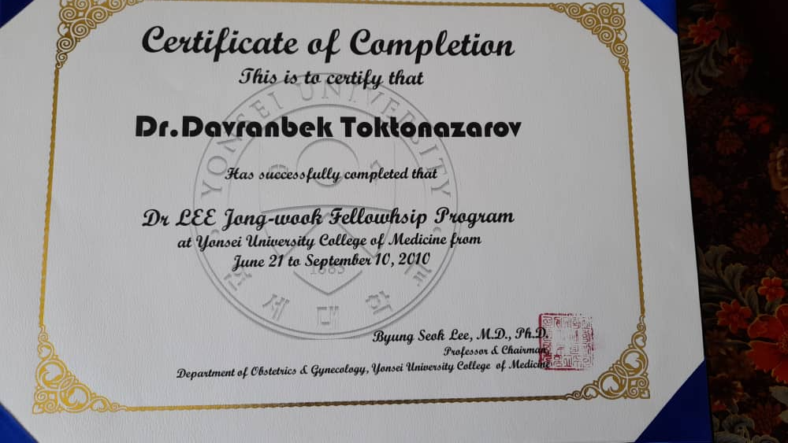
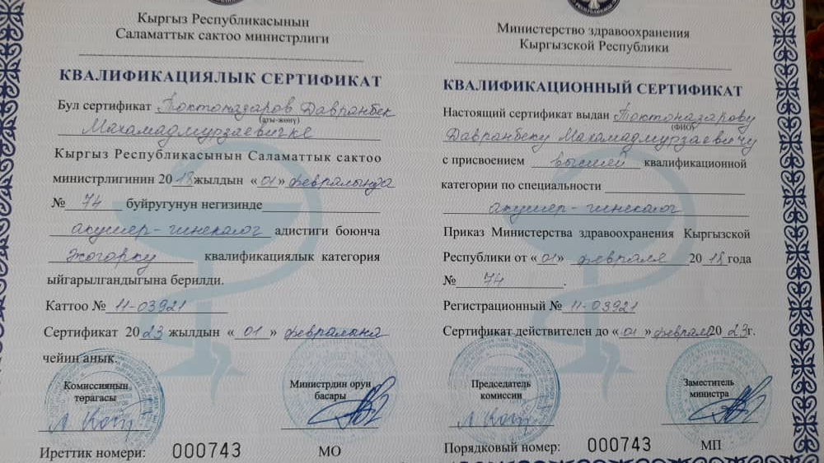
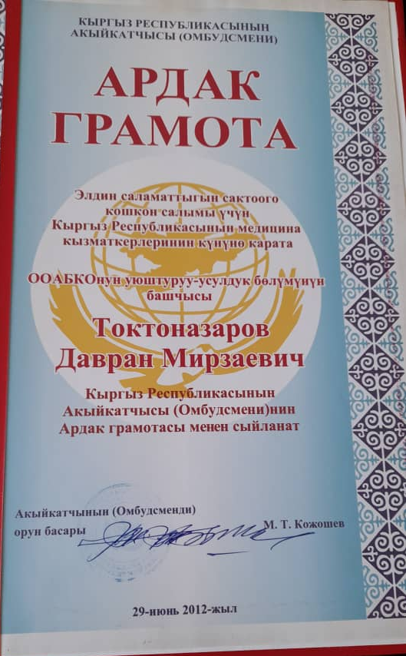
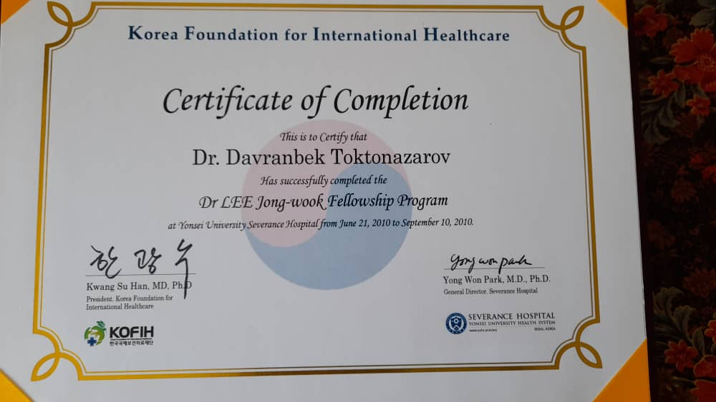
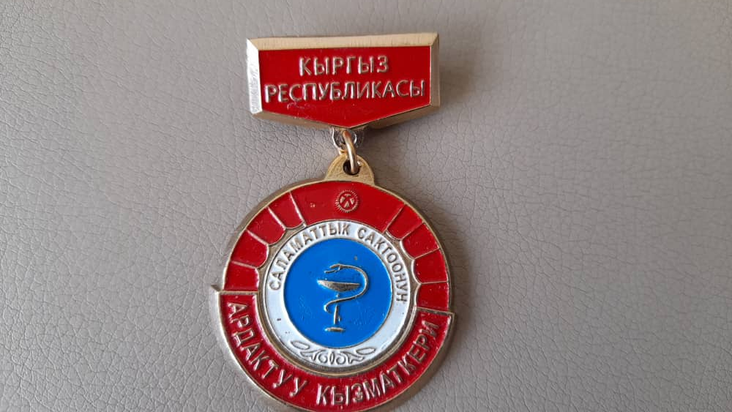
Achievements

Slide 5
Contact
Occupation: International Medical Faculty, Osh State University
E-mail: doctordavran@mail.ru
Mob: 0 550 781 781

