Slide 1
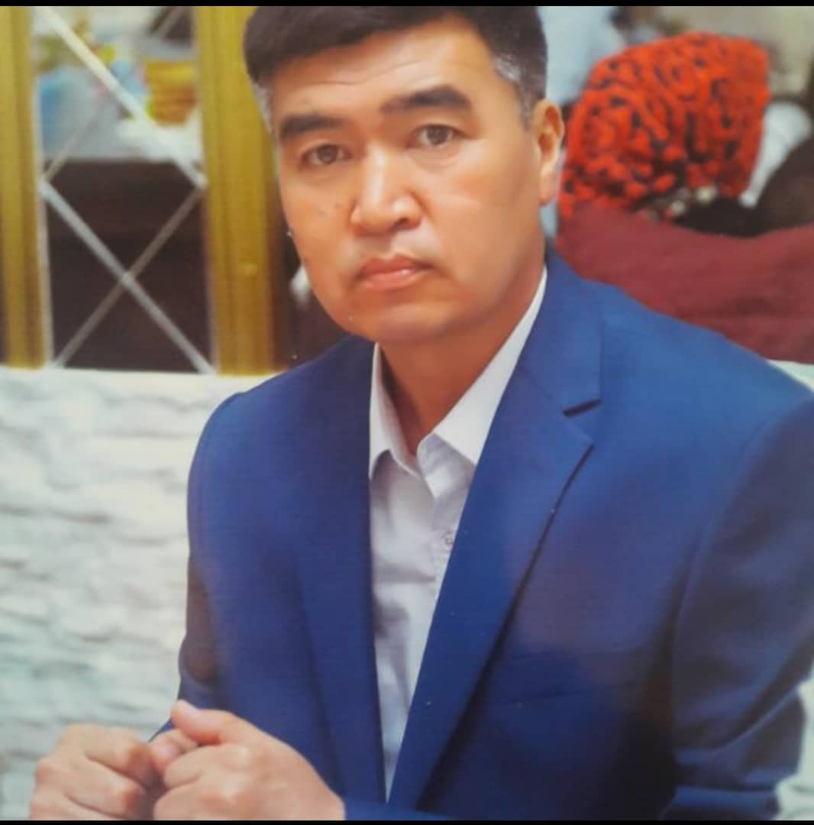
JAPAROV KELDIBEK

Slide 2
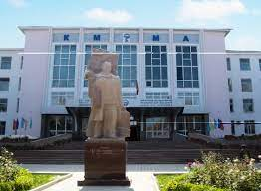
PERSONAL INFORMATION
Born in 1970, Kyrgyz.
In 1994 graduated from the KSMA, Faculty of Pediatric.
Candidate of Medical Sciences since 2019. Defended the thesis on the topic “Ways to improve the provision of primary specialized medical care " on may06, 2019 at the Dissertation Council K. 14.02.03 at the Kyrygyz-Russian Slavic University
Pedagogical work experience in universities - 8 years, including at Osh State University - 4 years. The general experience is 24 full years
Field of professional activity: surgery, pediatric surgery

Slide 3
Publications
Have over 17 publications, including 12 scientific and 2 educational and methodological.
After defending the dissertation, 2 scientific and 1educational-methodical works used in pedagogical practice were published.

Slide 4
Key qualifications
1. 1994/1995 Certificate "On the end of the internship in the specialty of pediatric surgery" Osh Regional Children's Hospital. 1995 year
2. 10/05/2001 / 11/01/2001 Certificate "Selected issues of surgery" of the Republican Center for Scientific and Practical Medicine, Osh 2001.
3. 05/13/2002 / 06/08/2002 Certificate "Topical issues of pediatric surgery." KSMIPiPK. Osh city 2002
4. 20.11.2006 / 20.03.2007. Certificate of primary specialization in the specialty "Family doctor". Osh city 2007
5. 07.24.2013 / 07.26.2013 Certificate "Questions of minimally invasive surgery" NCC Bishkek 2013
6. 09/02/2014 / 09/30/2014 Certificate of advanced training for the course "Training of heads of healthcare organizations" of the KSMIPiPK, Bishkek. 2014
7. 02/12/2020 / 02/25/2020. Certificate of advanced training "Psychology, Pedagogy" Osh. 2020
8. Certificate of advanced training for the course "Surgery of the gastrointestinal tract, thyroid and parathyroid glands, treatment and complication" Osh. 2020.

Slide 5
Contacts
Сell phone:
E-mail:
keldibek70japarov@mail.ru
+996-999125441 +996-772 125441,

