Slide 1
Karimova Nazgul Abdijalilovna
Associate professor, candidate of medical science

Slide 2
Education
1997/2003 :
Osh State University Faculty of Medicine General Medicine
2003/2005:
Osh State University PGF Obstetrician Gynecologist

Slide 3
Personal Information
01
02
03
04
Karimova Nazgul, born in 1980, Kyrgyz.
Highly qualified specialist
Candidate of Medical Science
Love travelling
Communicating with new people
Responsible
Field of professional activity: Obstetrics and gynecology

Slide 4
KEY QUALIFICATIONS / EXPERIENCE IN ACCREDITATION AND QUALITY ASSURANCE (TRAINING, SEMINARS, CONFERENCES, ETC.)
2016 | Certificate of Uteber Reading Participant in Shymkent
2017 | Certificate of advanced training at the scientific and practical conference "Menopausal hormone therapy". Hungary.
2018 | Certificate of participation in the international educational seminar "Dydrogesterone in miscarriage therapy" Rome.
2015 | Certificate of completion of the course "Primary neonatal resuscitation"
2014 | Certificate of completion of the course "Pedagogy of Zhana Psychology of Subjects Boyuncha bilimin Orkundotuu" Osh State University
2017 | Certificate for successful completion of the master training "Emergency care and intensive care in critical conditions in obstetrics", Bishkek, Kyrgyzstan.

Slide 5
Work Experience
2005-2016 - present - Osh city clinical hospital, city perinatal center, obstetrician-gynecologist.
2016.– Osh special hospital, colposcopist.
2005 -2011 –Osh State University Medical Faculty, Department of Obstetrics and Gynecology
2011 –2016 Osh State University PGF Department of Obstetrics and Gynecology
2016 Osh State University MMF Department of CD 2
2016 Head of the Department of Therapy PGF

Slide 6
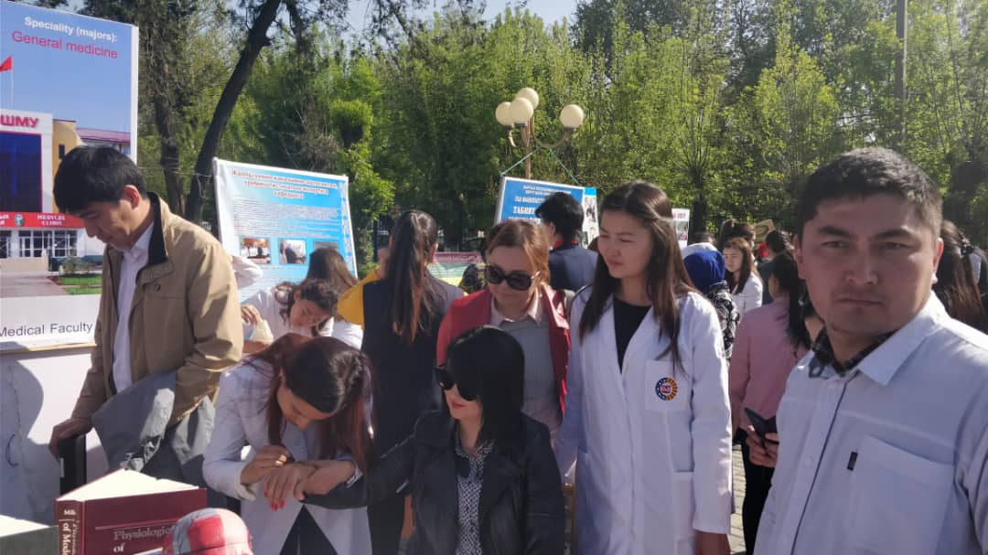
Working With Students

Slide 7
Contacts
Telephone:
0773648838
E-mail:
karimova.1980.nazgul@mail.ru

