Slide 1
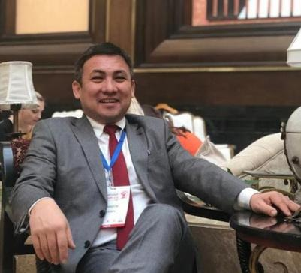
Askerov Arsen Askerovich
~professor, MD, PhD~

Slide 2
PERSONAL INFORMATION
Born in 1974, Kyrgyz.
in 1997 graduated from the medical faculty of the KSMA
In 2002 he successfully defended his candidate's dissertation, and in 2015 his doctoral dissertation
Pedagogical work experience in universities - 19 years, including at Osh State University - 1 years. The general scientific and pedagogical experience is 22 full years
Field of professional activity: obstetrics, gynecology, reproductology

Slide 3
Publications
Have over 75 publications, including 50 scientific and 11 educational and methodological.
After defending the dissertation, 50 scientific and 11 educational-methodical works used in pedagogical practice were published, including:
- methodological guide "Management of pregnancy and childbirth with previa and placenta accreta" - 2018.
- Guidelines for monitoring the quality of family planning medical services – 2017
- Clinical Guidelines for Safe Termination of Pregnancy – 2020
-Clinical guidelines for Covid 19 infection (4-5th version) of the Ministry of Health of the Kyrgyz Republic – 2020-2021.

Slide 4
Key qualifications
Certificate "Methodology for the development and evaluation of clinical guidelines" - Bishkek 2011
Сertificate "Treatment of pregnant women with HIV" - Salsburg 2016.
Сertificate "Clinical mentoring" - Almaty 2016,
Certificate «Quality Management in Health Care» - Bancock 2010, Buenos Aires 2014, Zimbabwe 2015, Barcelona 2016
Women's Reproductive Health Certificate - Amsterdam 2012, Tirana 2012, Paris 2014, Helsinki 2014, Budapest 2016, Geneva 2017
Рatent for invention "Method of surgical treatment of sexual dysuric disorders in women"

Slide 5
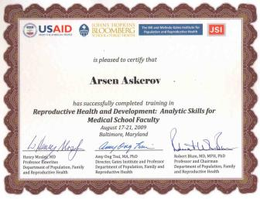
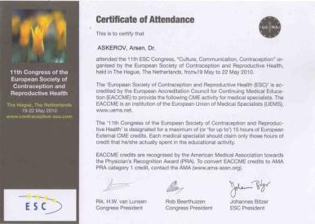

Slide 6
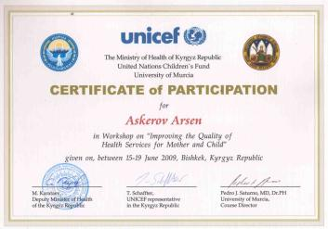
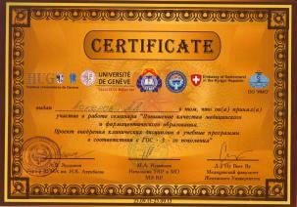

Slide 7
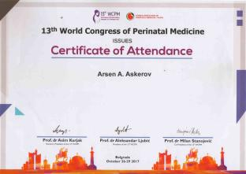
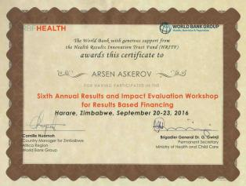
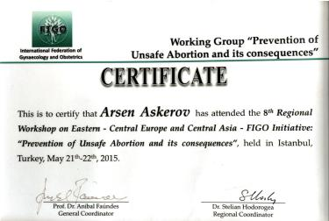

Slide 8
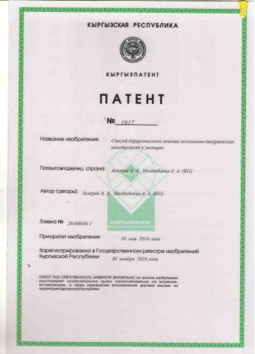
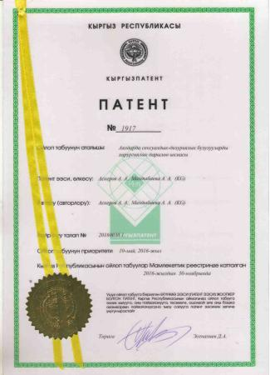
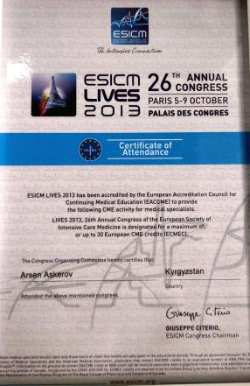

Slide 9
Work experience
2017-2021 Professor of the Department of Obstetrics and Gynecology, KRSU.
2012–2017: Head of the Department of Obstetrics and Gynecology No. 2 of the KSMA.
2002-2012: - Associate Professor of the Department of Obstetrics and Gynecology, KRSU
1999-2002: - doctor of the republican maternity hospital
1999 - Researcher, Kyrgyz Research Institute of Obstetrics and Pediatrics

Slide 10
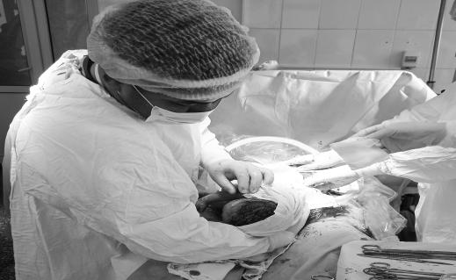
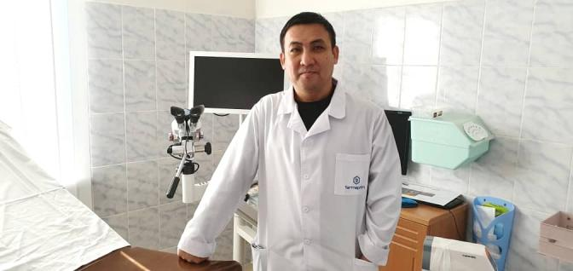
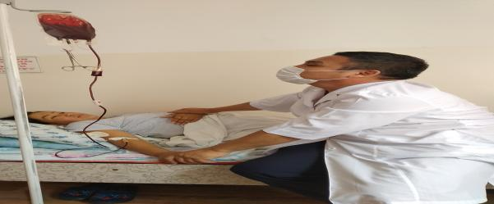

Slide 11
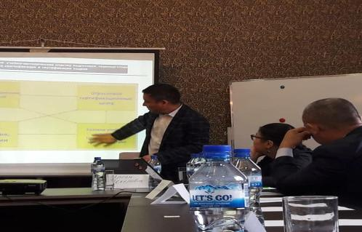
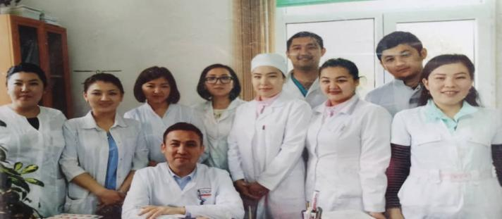

Slide 12
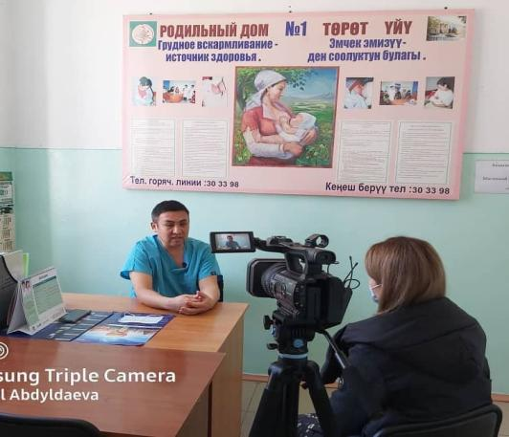
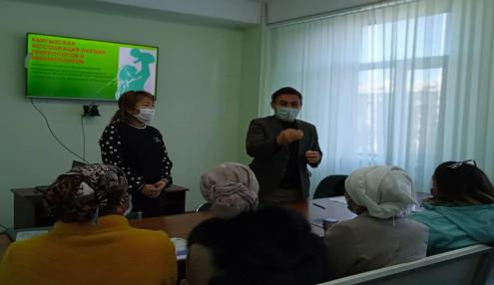
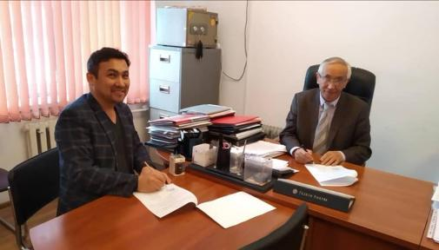

Slide 13
Contacts
Сell phone:
E-mail: askerov.arsen@inbox.ru
+996-550331731, +996700331731,

