Slide 1
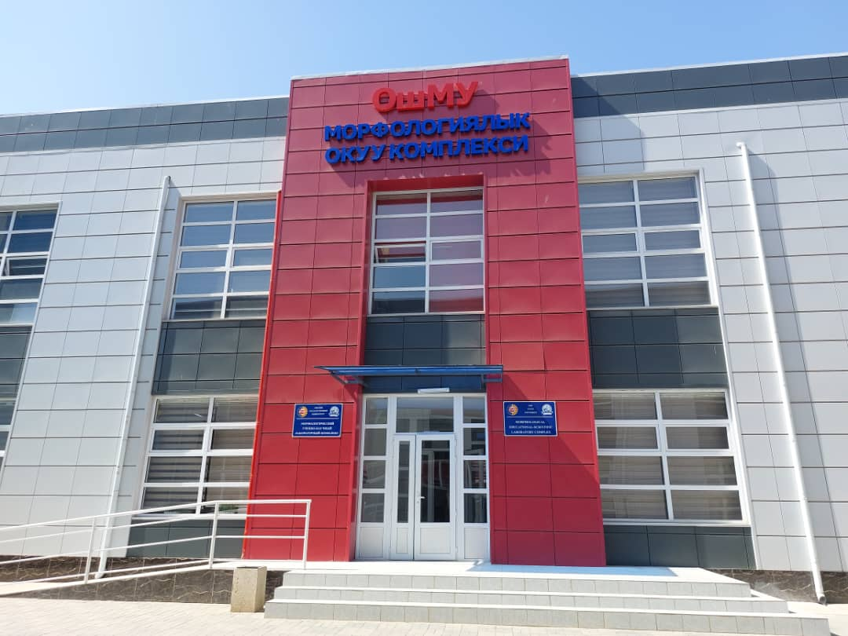

Slide 2
Anatomy TeacheRs

Slide 3
Tashimbetova Umut Kaparovna
Tashimbetova Umut Kaparovna, born in 1981, kyrgyz.
From 1998 – 2004. Osh State University Faculty of Medicine. Graduated with a qualification-medical doctor speciality-general medicine.
From 2004 - 2006 passed clinical internship and received a certificate-
«ophthalmologist»
Education:
Start / end date University Faculty Speciality
1998/2004 Osh State University Faculty of Medicine Medical doctor
2004/2006 КSМА Osh center of «ophthalmologist «
postgraduate
education

Slide 4
Ergeshova Aida Masalbekovna
Ergeshova Aida Masalbekovna, born in 1981, Kyrgyz
In 2004, graduated from the Osh State University Faculty of Medicine with a degree in Medical Science.
Experience of teaching at the university – 7 years at Osh Kyrgyz-Uzbek University.
Field of professional activity: morphology, human anatomy.
PERSONAL INFORMATION
LAST NAME Ergeshova
NAME Aida
MIDDLE NAME Masalbekovna
DATE OF BIRTH July 16, 1981
EDUCATION:
Start / End Date 1998/2004
Higher education institution Osh State University
Faculty Faculty of Medicine
Specialty Medical business

Slide 5
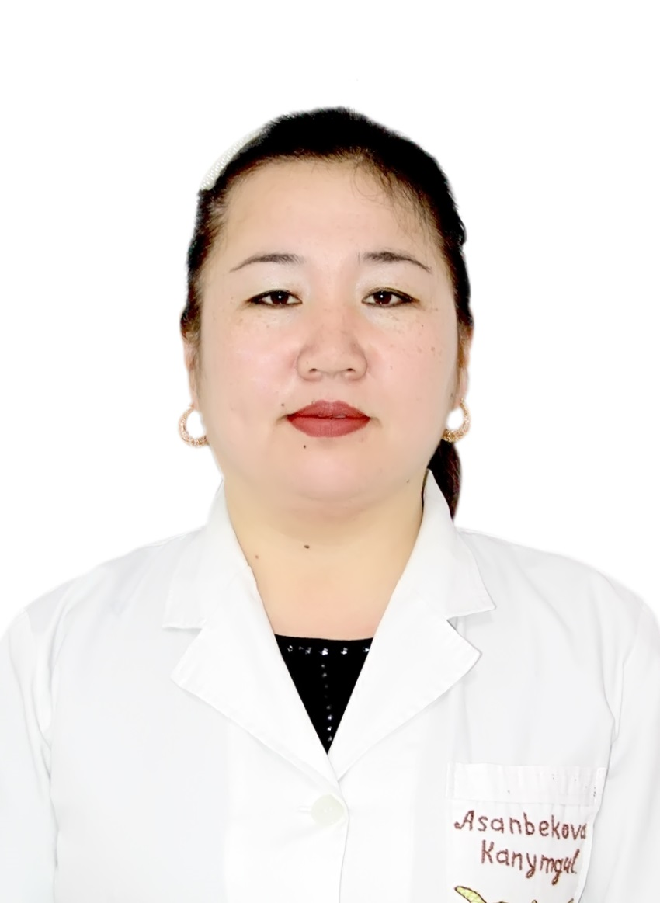
ASANBEKOVA KANYMGUL
Asanbekova Kanymgul, born in 1982, kyrgyz.
1999-2005 studied at the Osh State Medical Faculty.
2005-2007 passed clinical residency in the Osh regional maternity hospital.
EDUCATION:
Start / end date University Faculty Speciality
1999 / 2005 Osh State University Medical student
2005 / 2007 Osh clinical residency
WORK EXPERIENCE:
2013 worked as a doctor in the maternity ward
2013-2015 - Deputy director for organizational issues
2015-2016 - head of the maternity ward
since 2017 - teacher of the Osh State university, faculty of medicine

Slide 6
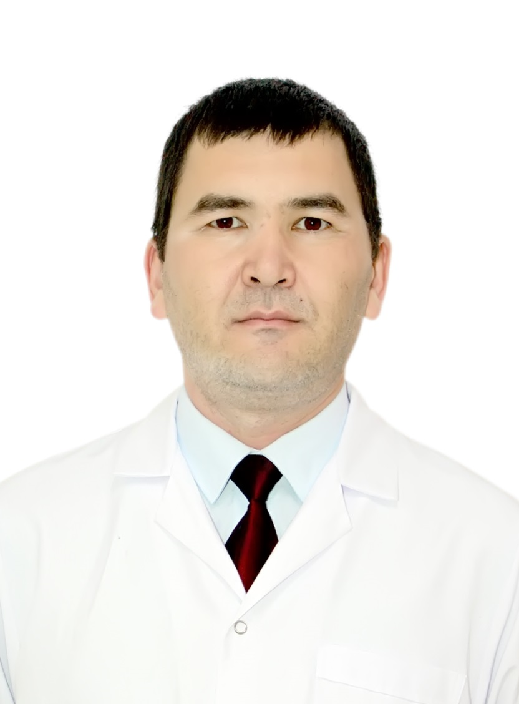
Ashimov Urmat Arstanbekovich
Ashimov Urmat Arstanbekovich , born in 1983 , Kyrgyz.
In 2011 year I was graduated from Medical Faculty of Osh State University.
Teaching experience including Osh State University - 6 years.
Cardiologist, lecturer at Anatomy
Married, have five children
EDUCATION:
Start / end date University Faculty Speciality
2000 / 2006 Ankara University Medical student
2008 / 2011 Osh State University Medical student
2011 / 2013 Osh State University Faculty of Cardiologist
Postgraduate
Education of Osh
State University

Slide 7
Maksimova Kanyshai Zaripovna
Maksimova Kanyshai, born in 1983, kyrgyz.
In 2006, he graduated from the medical faculty of Osh State University with a degree in general medicine.
Teaching experience in universities - 12 years, including at Osh State University - 12 years. General scientific and pedagogical experience - 21 full years.
Field of professional activity: anatomy, neurology
EDUCATION:
Start / end date University Faculty Speciality
2000 / 2006 Osh State University Medical student
2006 / 2008 ЦПМО

Slide 8
Toichieva Zarina Zhamaldinovna
Kyrgyz Republic Karasuisky District, Kenzhekul Village
Year of birth: 31.12. 1983г
Education:
Higher education: 2000-2006 Osh State University Medical Institute. 2006-2008 Osh State University Received qualification on speciality "doctor-pediatrician«
Specialty: Pediatrician and Neonatologist
Labor activity:
2008 -2009 Teacher on pediatrics. OshSU Medical College
2010-2011y.doctor-neonatologist ,Regional hospital maternity hospital, department of newborns.
Ped. Experience: 13 years.

Slide 9
Toktorov Kanzharbek Minbaevich
Date of birth: April 28, 1995
City: Osh
E D U C A T I O N
SPECIALITY month/year – month/year
Osh State University, Faculty of Medicine 09/2012 – 07/2018
General medicine
W O R K E X P E R I E N C E
POSITION AT WORK month/year – month/year
Alay Territorial Hospital 09/2018 – 07/2021
Functional responsibilities:
Resident doctor
POSITION AT WORK month/year – month/year
MC "OIOKH", Osh city. 01/2021 – present time
Functional responsibilities surgeon

Slide 10
Physiology Teachers

Slide 11
Argynbaeva Akmaral Turdalievna
Argynbaeva Akmaral Turdalyevna,
professor of biological sciences (2015), docent of Osh StateUniversity (2022).
Argynbaeva Akmaral Turdalievna was born on October 15, in 1982 in Karasuu region of Osh oblast.
In 2004 she graduated from the department "Natural Sciences and Geography" of Osh State University in Biology with complementary Chemistry. In 2007-2010 she studied at the post-graduate school Southern Branch of the
National academy of sciences.
Currently she is working as the docent at the Department of Anatomy, Histology and Normal Physiology” of the international Faculty of Medicine,
Osh
State University.
Scientific work of Argynbayeva A.T. is devoted to the study of violations of
microecology of the intestine under the affect of pesticides and its correction with probiotics. Scientific novelty of the work lies in in-depth study of themicroecological status of people,engaged in cotton growing in the Kyrgyz Republic and in contact with pesticide. In 2015 she defended her PhD dissertation on the topic: Violation microecology of the intestine exposure to pesticides and their correction with probiotics.
She is the author of more than 30 scientific and educational and methodical works in local and foreign publications.
Akmaral conducts practical and lecture classes in the discipline "Normal Human Physiology".

Slide 12
Paizildaev Timur
P E R S O N A L D A T A
I teach human physiology for MBBS students
E X P E R I E N C E
Lecturer in physiology
IMF, OshSU| august 2015 г. - ... Physiology is the study of normal function within living creatures. It is a sub-section of biology, covering a range of topics that include organs, anatomy, cells, biological compounds, and how they all interact to make life possible.
E D U C A T I O N
OshSU
Faculty of Medicine, September 2009. - 2015 г.
- Medicine "560001"
Postgraduate training in June 2015. - August 2016. - "Surgery".
Advanced training - May 2016 - September 2016 - "Gastroscopy"

Slide 13
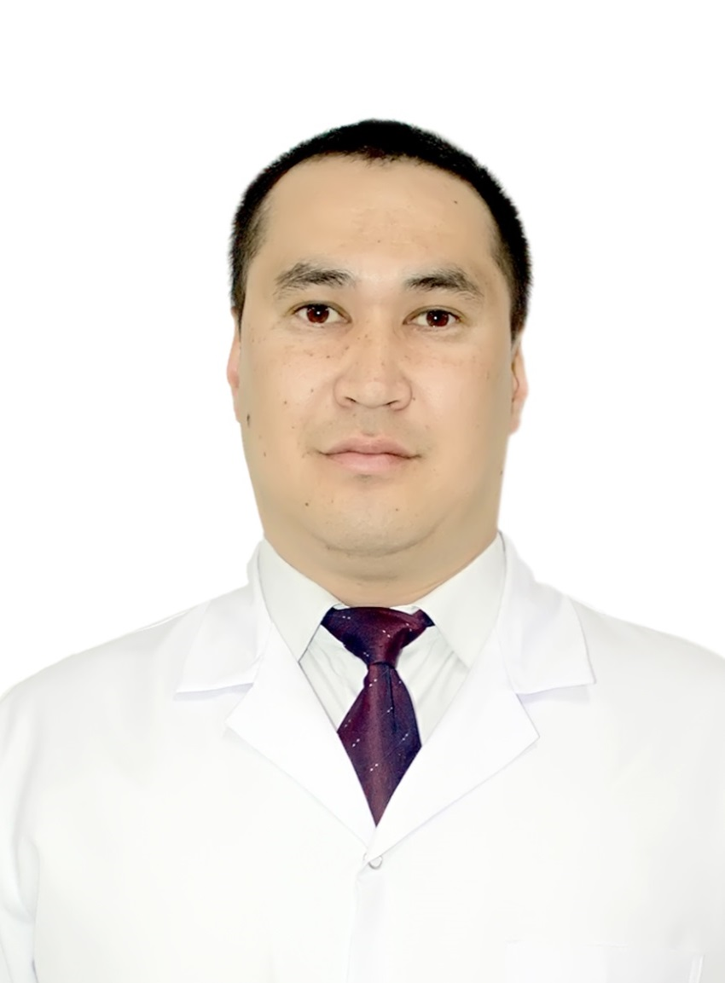
Baigashkaev Ertegin Saparbekovich
EDUCATION
2010-2016 Osh State University, Faculty of Medicine, General Medicine
2016-2018 Faculty of postgraduate education, surgery.
2018-2020 Master of Osh State University with a degree in Public Health
2020-2021 Ultrasound procedure
WORK EXPERIENCE
2018-2019 Ambulance
2021-I currently work at the Andromed Medical Clinic, a surgeon.
2016- present time lecturer of department of anatomy, histology and normal physiology, IMF.
PROFESSIONAL SKILLS
Laboratory work inclination
Olympiad preparations
Scientific and educational work
Development and introduction of interactive methods
Differential approach

Slide 14
Orozbek uulu Tursunbek
EDUCATION
2012-2018 Osh State University, Faculty of Medicine, General Medicine
2018-2021 Faculty of postgraduate education, surgery.
2021 September-December, Advanced training, anesthesiologist-anesthesiologist
WORK EXPERIENCE
2018-2021 Osh Regional Mental Health Center,
nurse.
2018-2019 methodologist, IMF
2019- present time lecturer of department of anatomy, histology and normal physiology, IMF
PROFESSIONAL SKILLS
Laboratory work inclination
Olympiad preparations
Scientific and educational work
Development and introduction of interactive methods
Differential approach
Individual technigue

Slide 15
Histology Teachers

Slide 16
Tashmatova Nazgul Mamatumarovna
About Me
Tashmatova Nazgul Mamatumarovna, born in 1978, Kyrgyz. In 2000 she graduated with honours degree in natural sciences and geography from Osh State University, speciality "Biology teacher with additional chemistry".
Candidate of Biological Sciences since 2016. Dissertation on "Morphological characteristics of the mature placenta in physiological conditions with regard to age, constitutional and ethnic factors" defended on 27-may 2016 in the dissertation council of D 001.037.01 of Federal State Budget Scientific Institution "Institute of Molecular Pathology and
Pathomorphology".
Candidate of Biological Sciences, Bishkek, nostrificated by Higher Attestation Commission from 23.06.2017, protocol № 6pk-3/4
Experience of pedagogical work in HEIs - 12 years, including 22 years in Osh State University. Total scientific and pedagogical experience - 22 full years.
Sphere of professional activity: morphology, cell biology, cytology and histology
Achievements
From May 2013 to 2016. - Senior lecturer of the Department of Histology and Pathanatomy of the Faculty of Medicine of OshSU.
In May 2016. She defended her PhD thesis on the topic: "Morphological characteristics of the mature placenta in physiological conditions with regard to age, constitutional and ethnic factors" in the dissertation council D 001.037.01 of Federal State Budget Scientific Institution "Institute of Molecular Pathology and Pathomorphology" Novosibirsk, Russia. 03.03.
From 1.09.16 - 9.09.17 - Senior lecturer of the Department of Morphological Disciplines of the International Faculty of Medicine.
From 19.09.17 - 1.09.2018 Acting Associate Professor of the Department of Morphological Disciplines.
Since 1.09.2018 Acting Associate Professor of the Department of Anatomy, Histology and Normal Physiology From 1.12.16 to 2022 - Vice-dean for scientific work of the International Medical Faculty of Osh State University
The best curator of OshSU - 2012 Grand Prize The best teacher of OshSU - 2013 4th place
The best educational and methodical complex OshSU - 2018
The best monograph OshSU - 2018 3rd place

Slide 17
Toroev Durusbek Isanovich
Lecturer in General Histology, Cytology and Embryology
Total work experience: 48 years
Work experience at Osh State University: 26 years
Education:
Osh State Pedagogical Institute, Faculty of Biology, specialty - Biology and Chemistry, 1977 - 1984.
Postgraduate studies - Tashkent, VNIISH them. G.S. Zaitseva, 1986 - 1990
Master - India, Dehradun city, Indian Institute of Remote Sensing,
Labor activity:
Kyrgyz experimental station: Department of selection and seed production, positions - Researcher, Senior Researcher, Head department.
Osh State University, Faculty of Natural Science; Lecturer, Senior Lecturer, Head of the Department, Acting Associate Professor from 1996 to 2012.
Faculty of Medicine - Lecturer in the Department of Histology from 2013 to 2015.
International Faculty of Medicine - Lecturer in the Department of Anatomy, Histology and Normal Physiology from 2015 to the present.

Slide 18
Alimbekova Aiperi Alimbekovna
1. Alimbekova Ayperi Alimbekovna, born in 1994, Kyrgyz.
2. In 2018, she graduated from the Medical Faculty of OSH State University with a degree in "medicine".".
3. In 2021 she graduated from the Faculty of postgraduate education in the specialty “gastroenterologist”.
4. Field of professional activity: histology
LAST NAME Alimbekova
FIRST NAME Aiperi Alimbekovna
DATE December 22, 1994
WORK EXPERIENCE
• In 2018, she graduated from the Medical Faculty of Osh State University with a degree in Medical Science.
• 2018-2019 – Methodologist of the Department of Anatomy, Histology and Normal Physiology.
• 2019-to this day. – Lecturer of the Department of Anatomy, Histology and Normal Physiology.
Start/End date University

Slide 19
Bakirov Sanjar Bakirovich
Date of birth: March 22, 1995
City: Bishkek
E D U C A T I O N
SPECIALITY month/year – month/year
Osh State University, Faculty of Medicine 09/2012 – 07/2018
General medicine
W O R K E X P E R I E N C E
POSITION AT WORK month/year – month/year
National Centre of Oncology and Hematology (NCOH), Bishkek city. 09/2018 –07/2021
Functional responsibilities:
Resident doctor
POSITION AT WORK month/year – month/year
MC "LASMED", Bishkek city.
01/2020 -05/2021
Functional responsibilities: Oncologist

Slide 20
Manas kyzy Uulkan
Manas kyzy Uulkan, born in 1996, Kyrgyz
In 2017, she graduated from the Faculty of Natural Geography of OSH State University with a degree in biology.
In 2019, she graduated from the Master's degree in Natural Geography at OSH State University
2021-2022 studying for a master's degree at the International Medical Faculty of Osh State University.
PERSONAL INFORMATION
LAST NAME Мanas kyzy
NAME Uulkan
MIDDLE NAME ------
DATE OF BIRTH 28/04/1996
EDUCATION:
Start / End Date Higher education institution Faculty Specialty
2013-2019 Osh State Faculty of Biologist
University Natural
Geography

