Slide 1
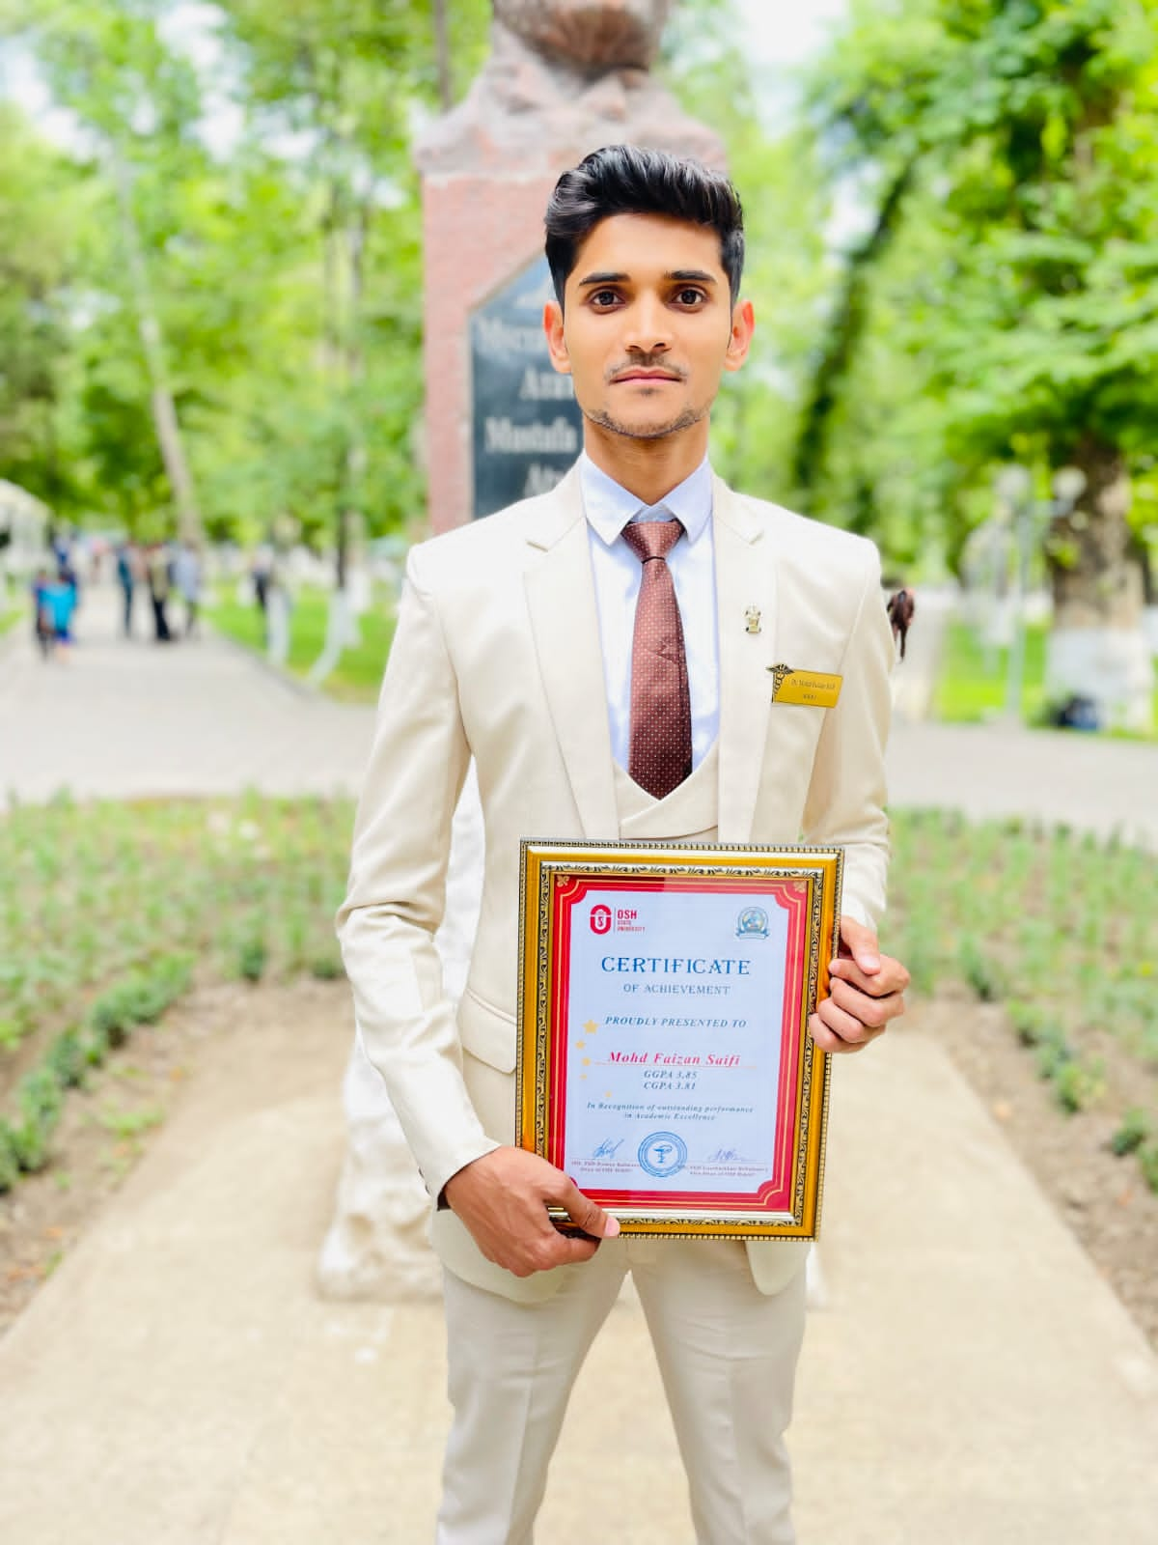
GROUP-7A
NAME- MOHD FAIZAN SAIFI
FATHER NAME-NAWAB SAIFI

Slide 2
*I AM RED DEGREE HOLDER (Scholar of OSHSU)
*I GOT 3.85 GENERAL GPA & 3.81 CURRENT GPA
*GOT 4TH POSITION IN 3RD SEMESTER AND 2ND POSITION IN 4TH SEMESTER
*PARTICIPATED IN SOME OLYMPIAD LIKE PATH ANATOMY, MICROBIOLOGY AND EPIDEMIOLOGY AND AWARDED IN EACH ONE OF THEM
*DONE RUSSIAN LANGUAGE COURSE WITH 5 POINTS
*RECEIVED THE TITLE OF MOST INNOCENT PERSON IN 6TH YEAR
*EXCELLENT SKILLS IN SINGING AND DELIVERING SPEECH

Slide 3
PERSONAL DETAILS
COLLEGE NAME- OSH STATE UNIVERSITY
ADDRESS IN OSH- ALAISKAYA 31A
MOBILE NUMBER- 919599516067
HOBBIES- READING AND COOKING
ABOUT ME- GENEROUS, BELIEVER AND COMPASSINATE
EMAIL- MOHDFAIZAN0804@GMAIL.COM

Slide 4
Thank you.
Class Teacher- Murzabek Kyzy Asel

