Slide 1
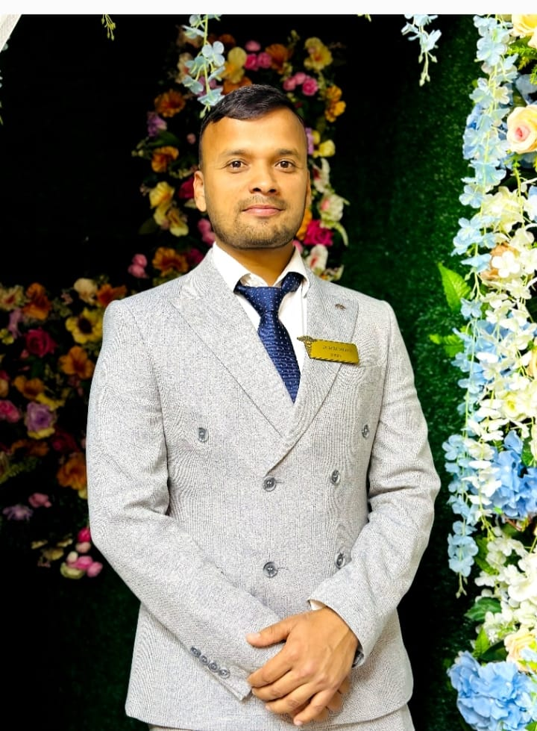
GROUP-7A
(MONITOR)
NAME- REHMAN ABDUL
FATHER NAME-MOHAMMAD RAFIQUE

Slide 2
*I AM RED DEGREE HOLDER.
*I GOT 3.83 GENERAL GPA & 3.90 CURRENT GPA
*GOT 4th POSITION IN 2nd SEMESTER AND 1ST POSITION IN 4TH SEMESTER
*PARTICIPATED IN OLYMPIAD LIKE PATH ANATOMY
*DONE LANGUAGE COURSE WITH 5 POINTS
*RECEIVED MAN OF THE MATCH IN CRICKET GAME TOURNAMENT.
*DOING EACH AND EVERYTHING ON TIME DURING MY ACADEMICS.

Slide 3
PERSONAL DETAILS
COLLEGE NAME- OSH STATE UNIVERSITY
ADDRESS IN OSH- ALAISKAYA 31A
MOBILE NUMBER- 918535074792
HOBBIES- PLAYING CRICKET AND LISTENING MUSIC
ABOUT ME- VERY HUMBLE AND KIND PERSON
EMAIL- REHMAN.ABDUL.1992.16@GMAIL.COM

Slide 4
Thank you.
Class Teacher-Murzabek Kyzy Asel

