Slide 1
College of International Education Programs

Slide 2
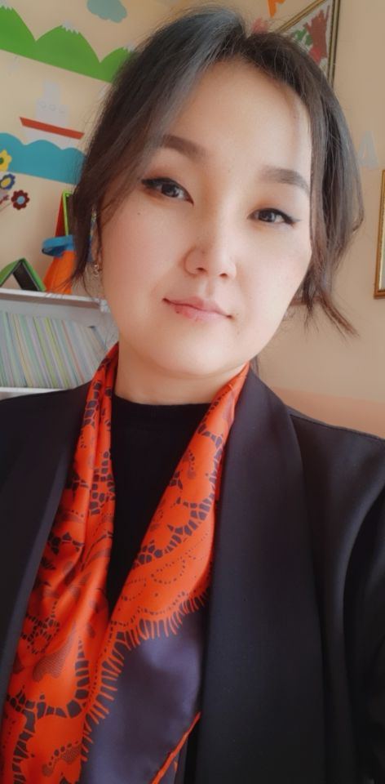
English teacher
Kirgizbaeva Toktaiym Abdullaevna

Slide 3
DATE AND PLACE OF BIRTH - 22.12.1989, OSH CITY, UZGEN DISTRICT, KYZYL-DYIKAN VILLAGE
NATIONALITY - KYRGYZ
CITIZENSHIP - RF
PLACE OF WORK: OSH STATE UNIVERSITY
POSITION: TEACHER AT THE DEPARTMENT OF TRANSLATOR
WORK EXPERIENCE - 1
EXPERIENCEIN OSHSU –SINCE SEPTEMBER 2023
MOBILE PHONE:+996553039316
E-MAIL: toktaiymkirgizbaeva@gmail.com

Slide 4
EDUCATION
2022 – Osh State University, Faculty of World Languages and Cultures (Master’s degree). Philological education of a foreign language.
2008-2013 – Osh Technological University, Faculty of Management and International Relations. Qualification: Linguist-translator
Work expierence:
10/11/2021-05/25/2022 English teacher. Private school “Nur-Tilek”, Uzgen.

Slide 5
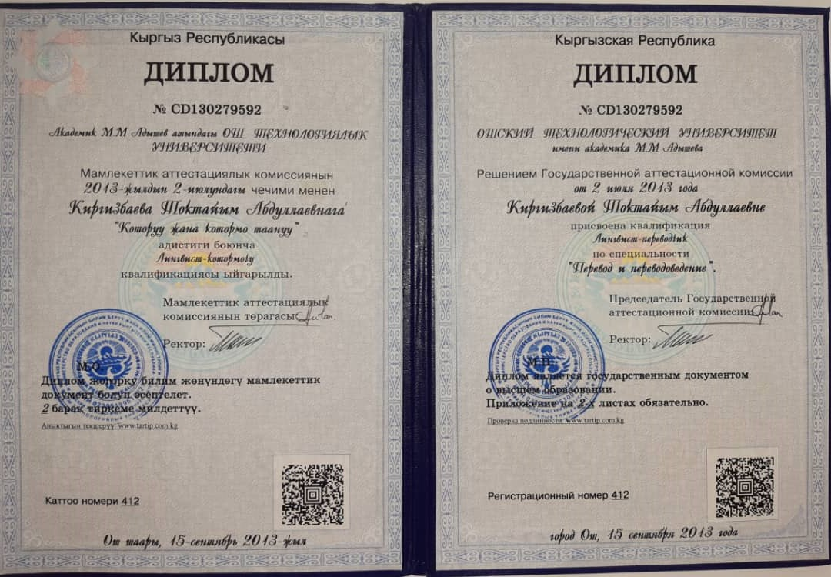

Slide 6
Thank you!

