Slide 1
Osh State University College of International Education Programs

Slide 2
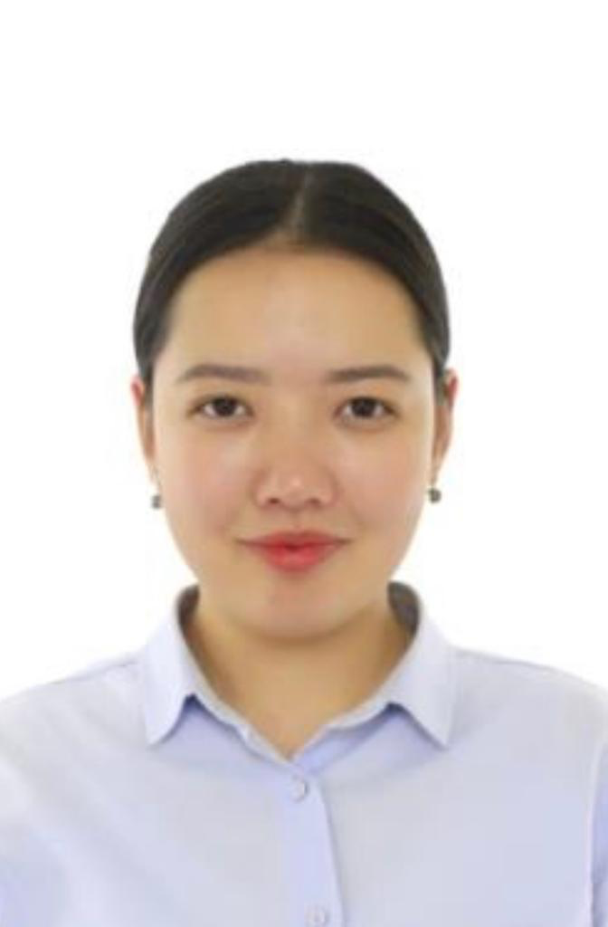
Janybekova Miraida
ENGLISH TEACHER

Slide 3
Date of birth: 14.09.2000
Citizenship : Kyrgyzstan
Nationality: kyrgyz
Telephones:+996779115133
Home address: Osh city.Kasymova 53
e-mail:mjnaybekova@gmail.com

Slide 4
Education
2018/2022 Osh state University
Faculty of world language and culture
WORK EXPERIENCE
2022 – Osh state University (laborant)

Slide 5
