Slide 1
Osh State University College of International Education Programs

Slide 2
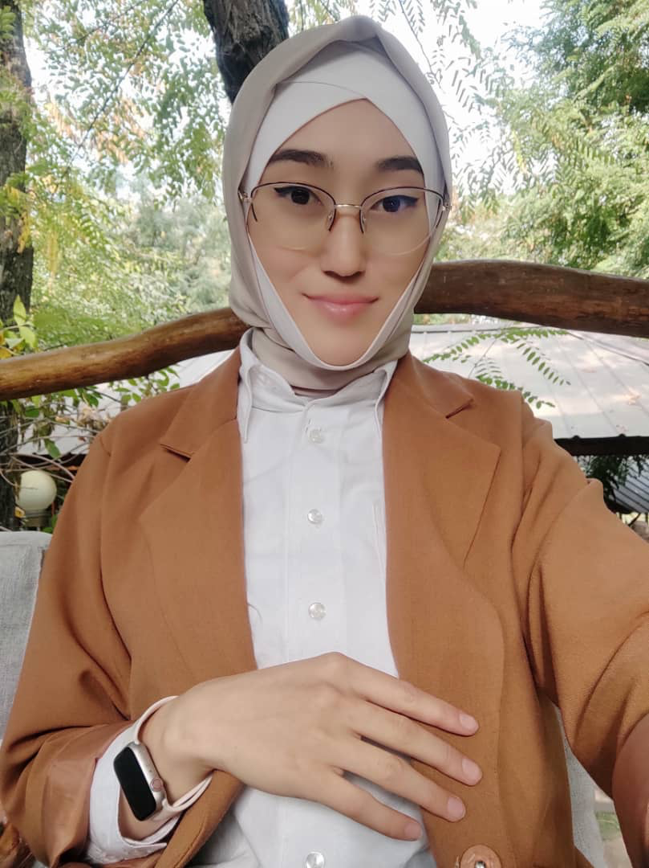
Bakir kyzy Maksatgul
ENGLISH TEACHER

Slide 3
Date of birth:14.10.1999
Citizenship : Kyrgyzstan
Nationality: kyrgyz
Telephones:+996502811996
Home address: Osh city.Salieva 14a
e-mail:mbakirova:
mbakirova141099@gmail.com

Slide 4
Education
2016/2020 Kyrgyz state University(bachelor degree) Ishenay Arabaev
WORK EXPERIENCE
2021 Asia Cambridge

