Slide 1
College of International Education Programs

Slide 2
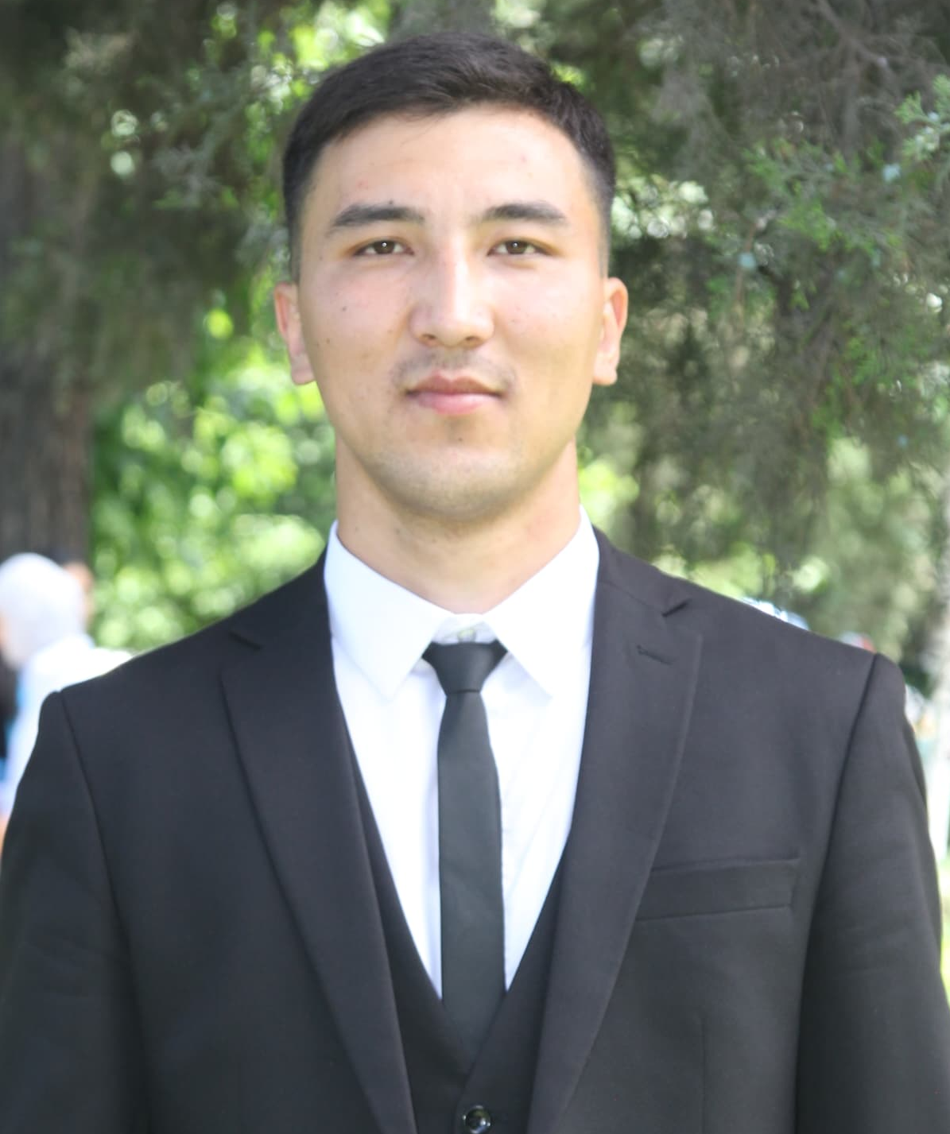
English teacher
Ysmanov Nursultan

Slide 3
DATE AND PLACE OF BIRTH – 16.10.2000, OSH CITY, ARAVAN DISTRICT, TOO-MOYUN VILLAGE
NATIONALITY - KYRGYZ
CITIZENSHIP - KYRGYZ REPUBLIC
PLACE OF WORK: OSH STATE UNIVERSITY
POSITION: TEACHER AT THE DEPARTMENT OF TRANSLATOR
WORK EXPERIENCE - 1
EXPERIENCEIN OSHSU – SINCE SEPTEMBER 2023
MOBILE PHONE:+996774233020
E-MAIL: nurik.kg.270@gmail.com

Slide 4
EDUCATION
Osh State University, Faculty of World Languages and Cultures,
Philological education of a foreign language.
2018-2022 –Qualification: Philological education
Work expierence:
01/09/2022-09/10/2023 English teacher at school, school named after the Syrt negizgi mektebi.
10/10/2023 English teacher at college, college of international education programs, since October

Slide 5
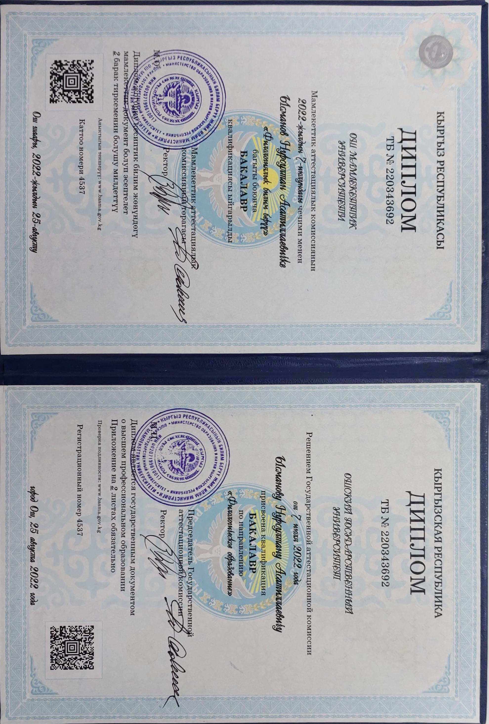

Slide 6
Thank you!

